Slide 1

We Welcome:

Slide 2
SLIDE DECK:
Quick history of immersion based ultrasonic tank cleaning and how USP came to be…
What is USP: Equipment- where & how installed. Types, ul, atex ce
How USP works
Key drivers for using the tech.
Who’s using USP: Clients/ Industries
TECHNICAL Parameters: Installation/ operation/ maintenance
Evaluating performance: equipment/ monthly calls
Process Candidates for USP: Determining fit
Budgets & logistics
FAQ’ s
Intake HX sheet link:
Notes:
While the ultrasonic bath provides a step change to process improvement, greener overall result, Clean in process tech, are the disruptive technologies that will change how processing industries in the near future manage critical assets in field.
OK…..so The system itself uses specialized ultrasonic transducers that get physically mounted to the heat exchangers at strategic locations on the tube sheet. A series of low powered ultrasonic generators provide the resonant frequency to drive the system.
The USP solution works in-line, allowing this scale prevention technology to work 24/7 while the heat train is in full operation. It uses high frequency, low displacement vibrations to prevent mineral scale and fouling build-up, from settling within the exchangers. The result is greater heat transfer efficiency and significantly lower operational-energy costs.

Slide 3
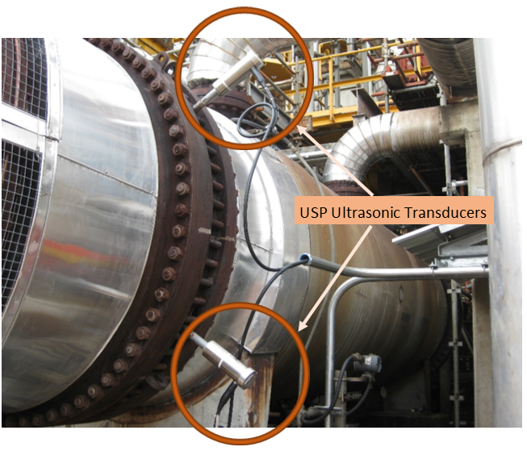
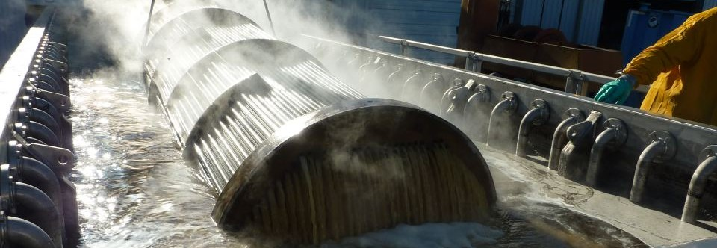
The evolution from Ultrasonic Immersion-Bath technology to a Clean-in-Process tech, using similar ultrasonic principles:
Notes:
The introduction of the ultrasonic bath provided a step change and a shake up in the cleaning industry, allowing many forms of Heat Exchangers to perform significantly better once back in process. While immediate gratification was felt through measureable overall-heat-transfer improvement, other benefits such as reduced operating fuel consumption, reduced cleaning costs and drastically reduced water use and waste-water recovery– made the ultrasonic bath an effect new tool for turn-around superintendents to avoid unnecessary costs, while meeting stated turnaround schedules and objectives.
Leveraging the same principles as the ultrasonic bath, our Clean-in-process technology, is a disruptive fouling mitigation solution that will change how processing industries in the near future manage critical assets in field.

Slide 4
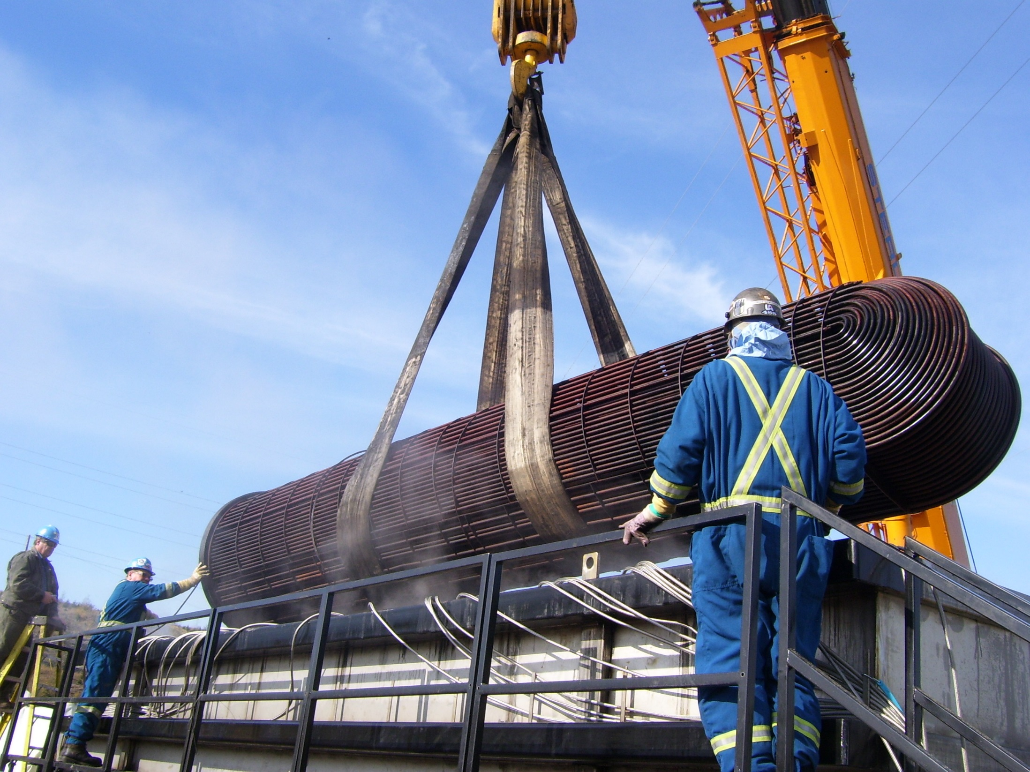
The very first heat exchanger cleaned by ultrasonic bath in November 2009, Fort McMurray, Alberta, Canada
SUNCOR Energy
Notes:
So before we take a deep dive into Ultrasonic Scale Prevention USP, our clean-in-place technology, I think its important to briefly, discuss the evolution and fit between both ultrasonic technologies.
The inception of ultrasonic immersion cleaning for shell and tube heat exchangers, was in November of 2009. We cleaned this heavily fouled, bitumen bundle for Suncor Energy, Fort McMurray Alberta, Canada. The success of this early trial led to the introduction of immersion cleaning being adopted at multiple Shell Oil sites in Canada.

Slide 5
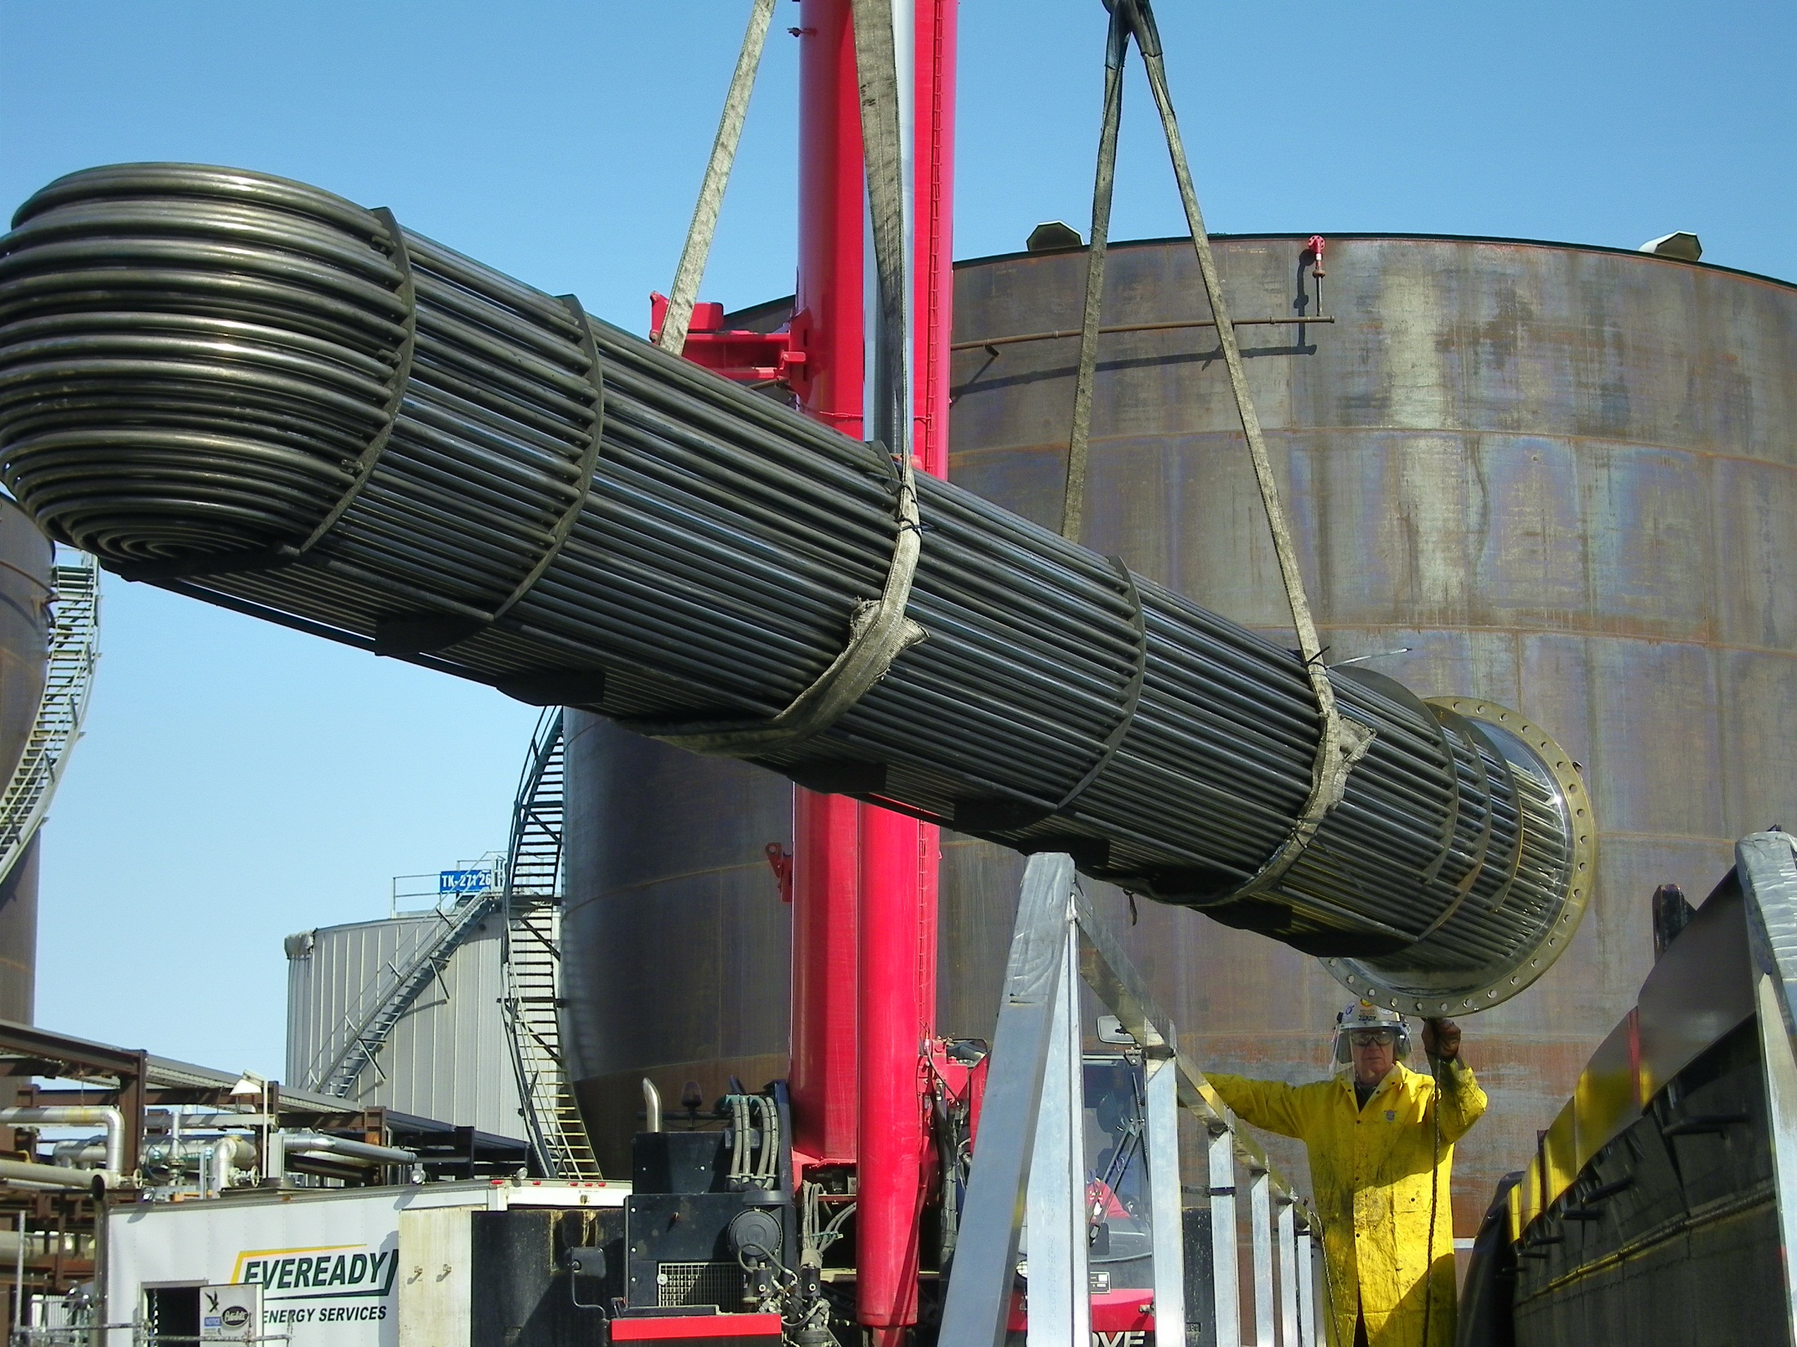

“The technology has proved to be a game-changer: providing energy savings, reduced environmental impact, improved heat transfer and measureable cost avoidance”.
Shell Chemical- Moerdijk,NL
Notes:
Before too long, Royal Dutch Shell’s head office in the Netherlands wanted to experience what Canada was gaining in terms of the heat transfer success and reduced operational and maintainance expenses firsthand.

Slide 6
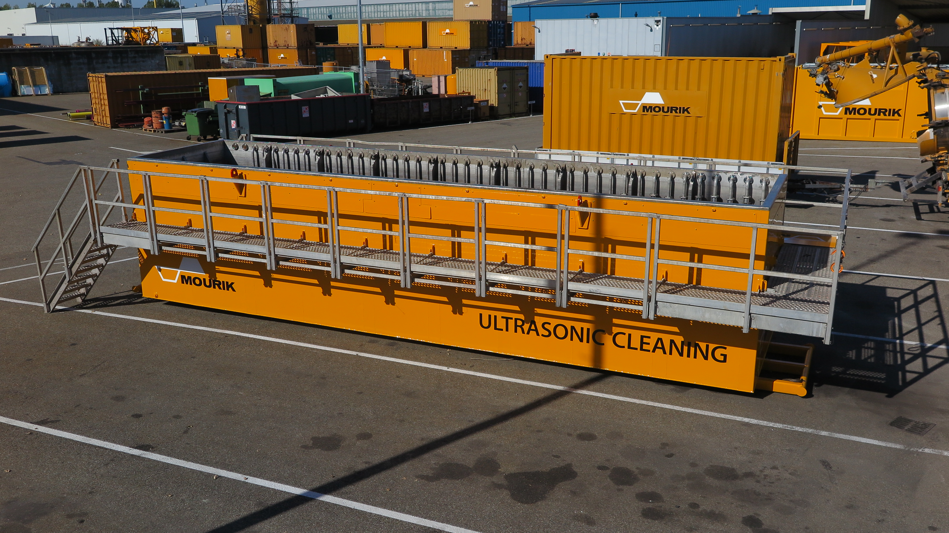
By 2012, the first European vessels had found a home with Mourik Services in Rotterdam, for specific contract work with Shell Moerdijk and Shell Pernis refineries
10m Ultrasonic Bath: 2016
Notes:
By 2012, the first European vessels had found a home with Mourik Services in Rotterdam, for specific contract work with Shell Moerdijk and Shell Pernis refineries

Slide 7
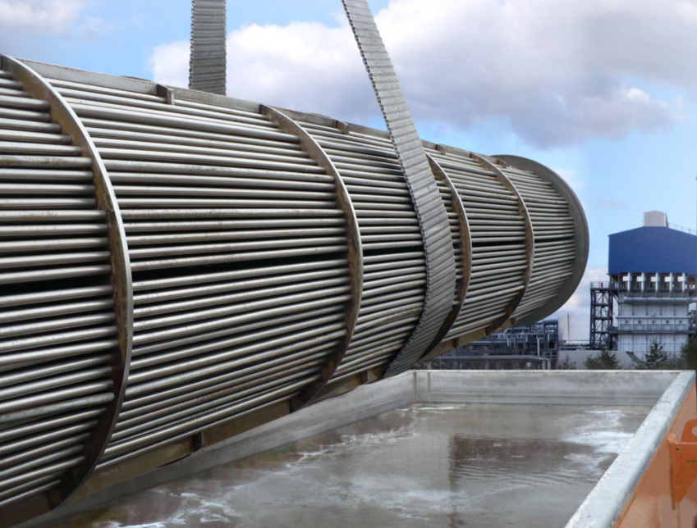
Acoustic Cleaning Baths
Will accommodate Hx units up to 8m in length
Axle allows for easy transport and set-up without needing a crane.
Essential Wave Technology (EWT). Purpose built ultrasonic generators and transducers to work in extreme conditions and temperatures.
Model: 2764AXL
Notes:
While immersion-based baths continue to evolve in design efficiency, cleaning effectiveness and utility, there are some limitations in their use…

Slide 8
What if the heat exchanger is too big for the bath or simply cannot be removed from the operating unit?
Can we clean this in
place?
Notes:
Through various industry conferences, educational symposiums and customer site, I delivered the benefits of ultrasonic immersion or tank cleaning technologies. Regardless of where I was in the World, the question was always the same. Russ, what’s next for clean-in-place?
While the sonic immersion process is very well received and effective, there were so many more assets in similar duty that could not be cleaned, because they were too large, or it simply wasn’t economical to clean them outside the operating unit.

Slide 9
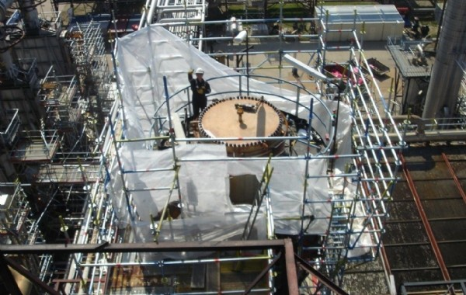
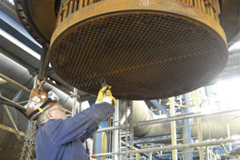
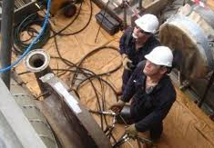
Clean in place Vs. Clean-in-Process
Notes:
While various clean in place methods including: chemical circulation and flex-lance water jet/mechanical, have been around for a number of years now, the idea of CLEAN-IN-PROCESS, or cleaning while on-line— is something different altogether.
This has and will continue to be game-changing for many industries. It allowed us to ask the question… What if you could SKIP a regular cleaning interval? Better yet, what if you could skip more than ONE interval…

Slide 10
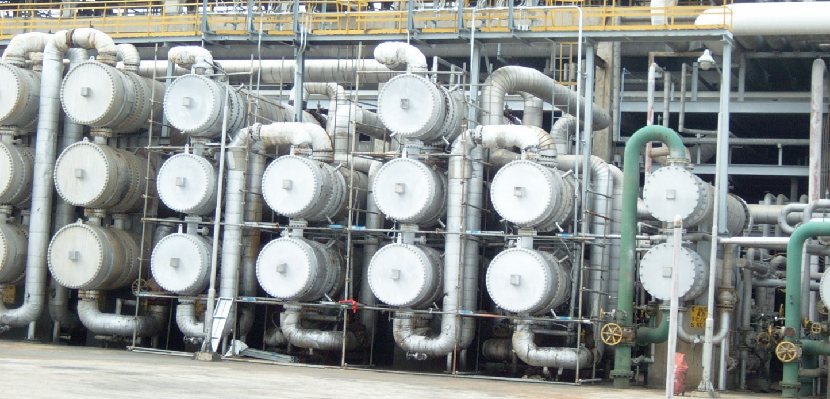

How much water can we save?
What if we could skip a regular cleaning interval on this entire heat-train?
How would this impact our overall profitability?
Notes:
This has and will continue to be game-changing for many industries. It allowed us to ask the question… What if you could SKIP a regular cleaning interval? Better yet, what if you could skip more than ONE interval…

Slide 11
Ultrasonic Scale Prevention-USP
A proprietary Clean tech that:
Works in-line, 24hrs/7days/wk
Strategically positioned ultrasonic transducers are affixed directly to the tubesheet
Converts electrical into mechanical energy which mitigates fouling on the heat transfer surfaces.
Notes:
Introducing Ultrasonic Scale prevention or USP
OK…..so The system itself uses specialized ultrasonic transducers that get physically mounted to the heat exchangers at strategic locations on the tube sheet. A series of low powered ultrasonic generators provide the resonant frequency to drive the system.
The USP solution works in-line, allowing this scale prevention technology to work 24/7 while the heat-train is in full operation. It uses high frequency, low displacement vibrations to prevent mineral scale and fouling build-up, from settling within the exchangers. The result is greater heat transfer efficiency and significantly lower operational-energy costs.

Slide 12
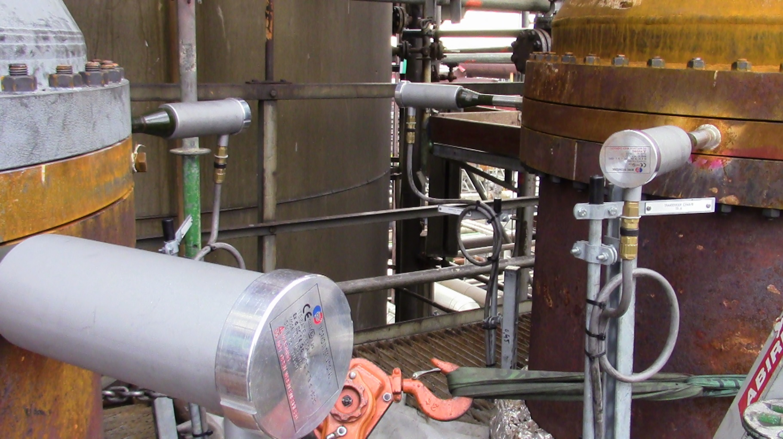
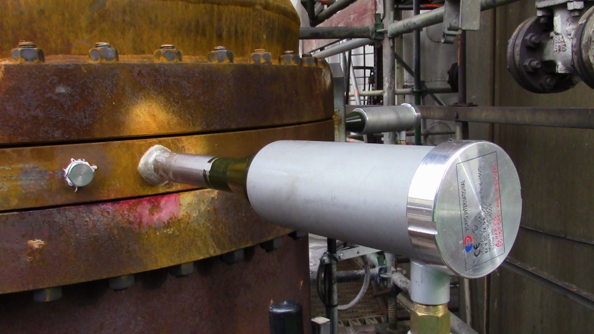
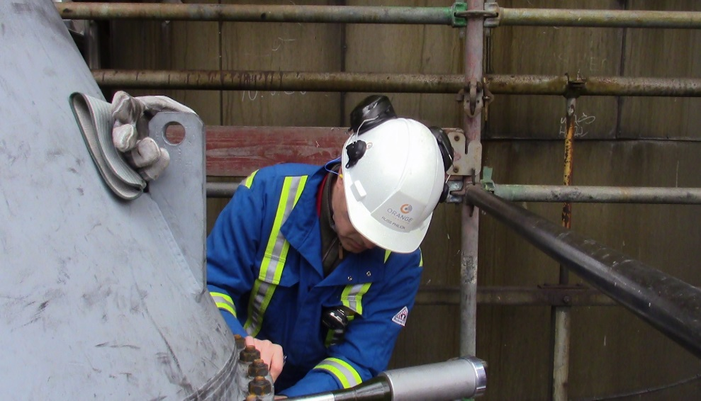
USP Transducers
Weld-on, pulse-actuated transducers are affixed directly to the tube sheet.

Slide 13
USP Transducers
Transducer location is determined through an analysis of historical fouling issues, Hx dimensions and parameters specific to the process candidate

Slide 14
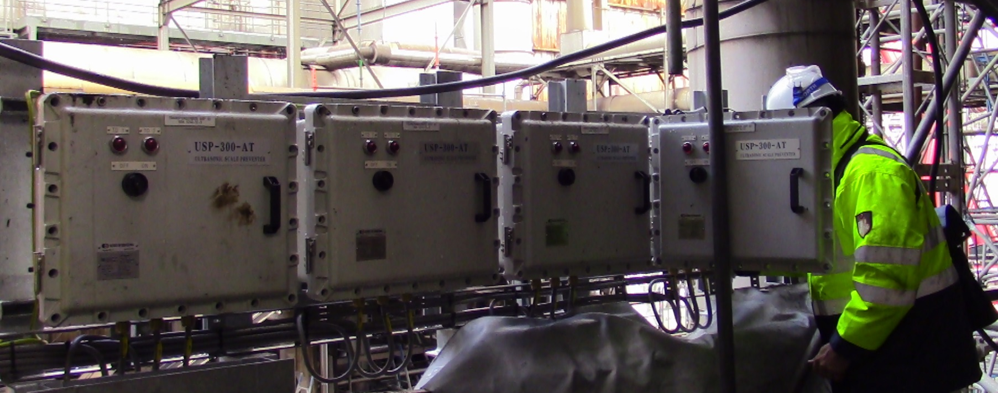
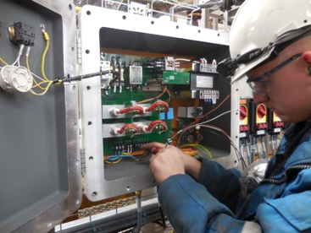
USP Generators
Specialized Ultrasonic generators provide pulsed-power from 30-100 micro-pulses p/s.
The setting is based on certain characteristics of the flowing media: type, viscosity, temperature, flow-rate.
The systems are configured under: UL,CE and ATEX certifications.
Division Classification 1
220Vac 60 Hz
230/240Vac 50 Hz

Slide 15
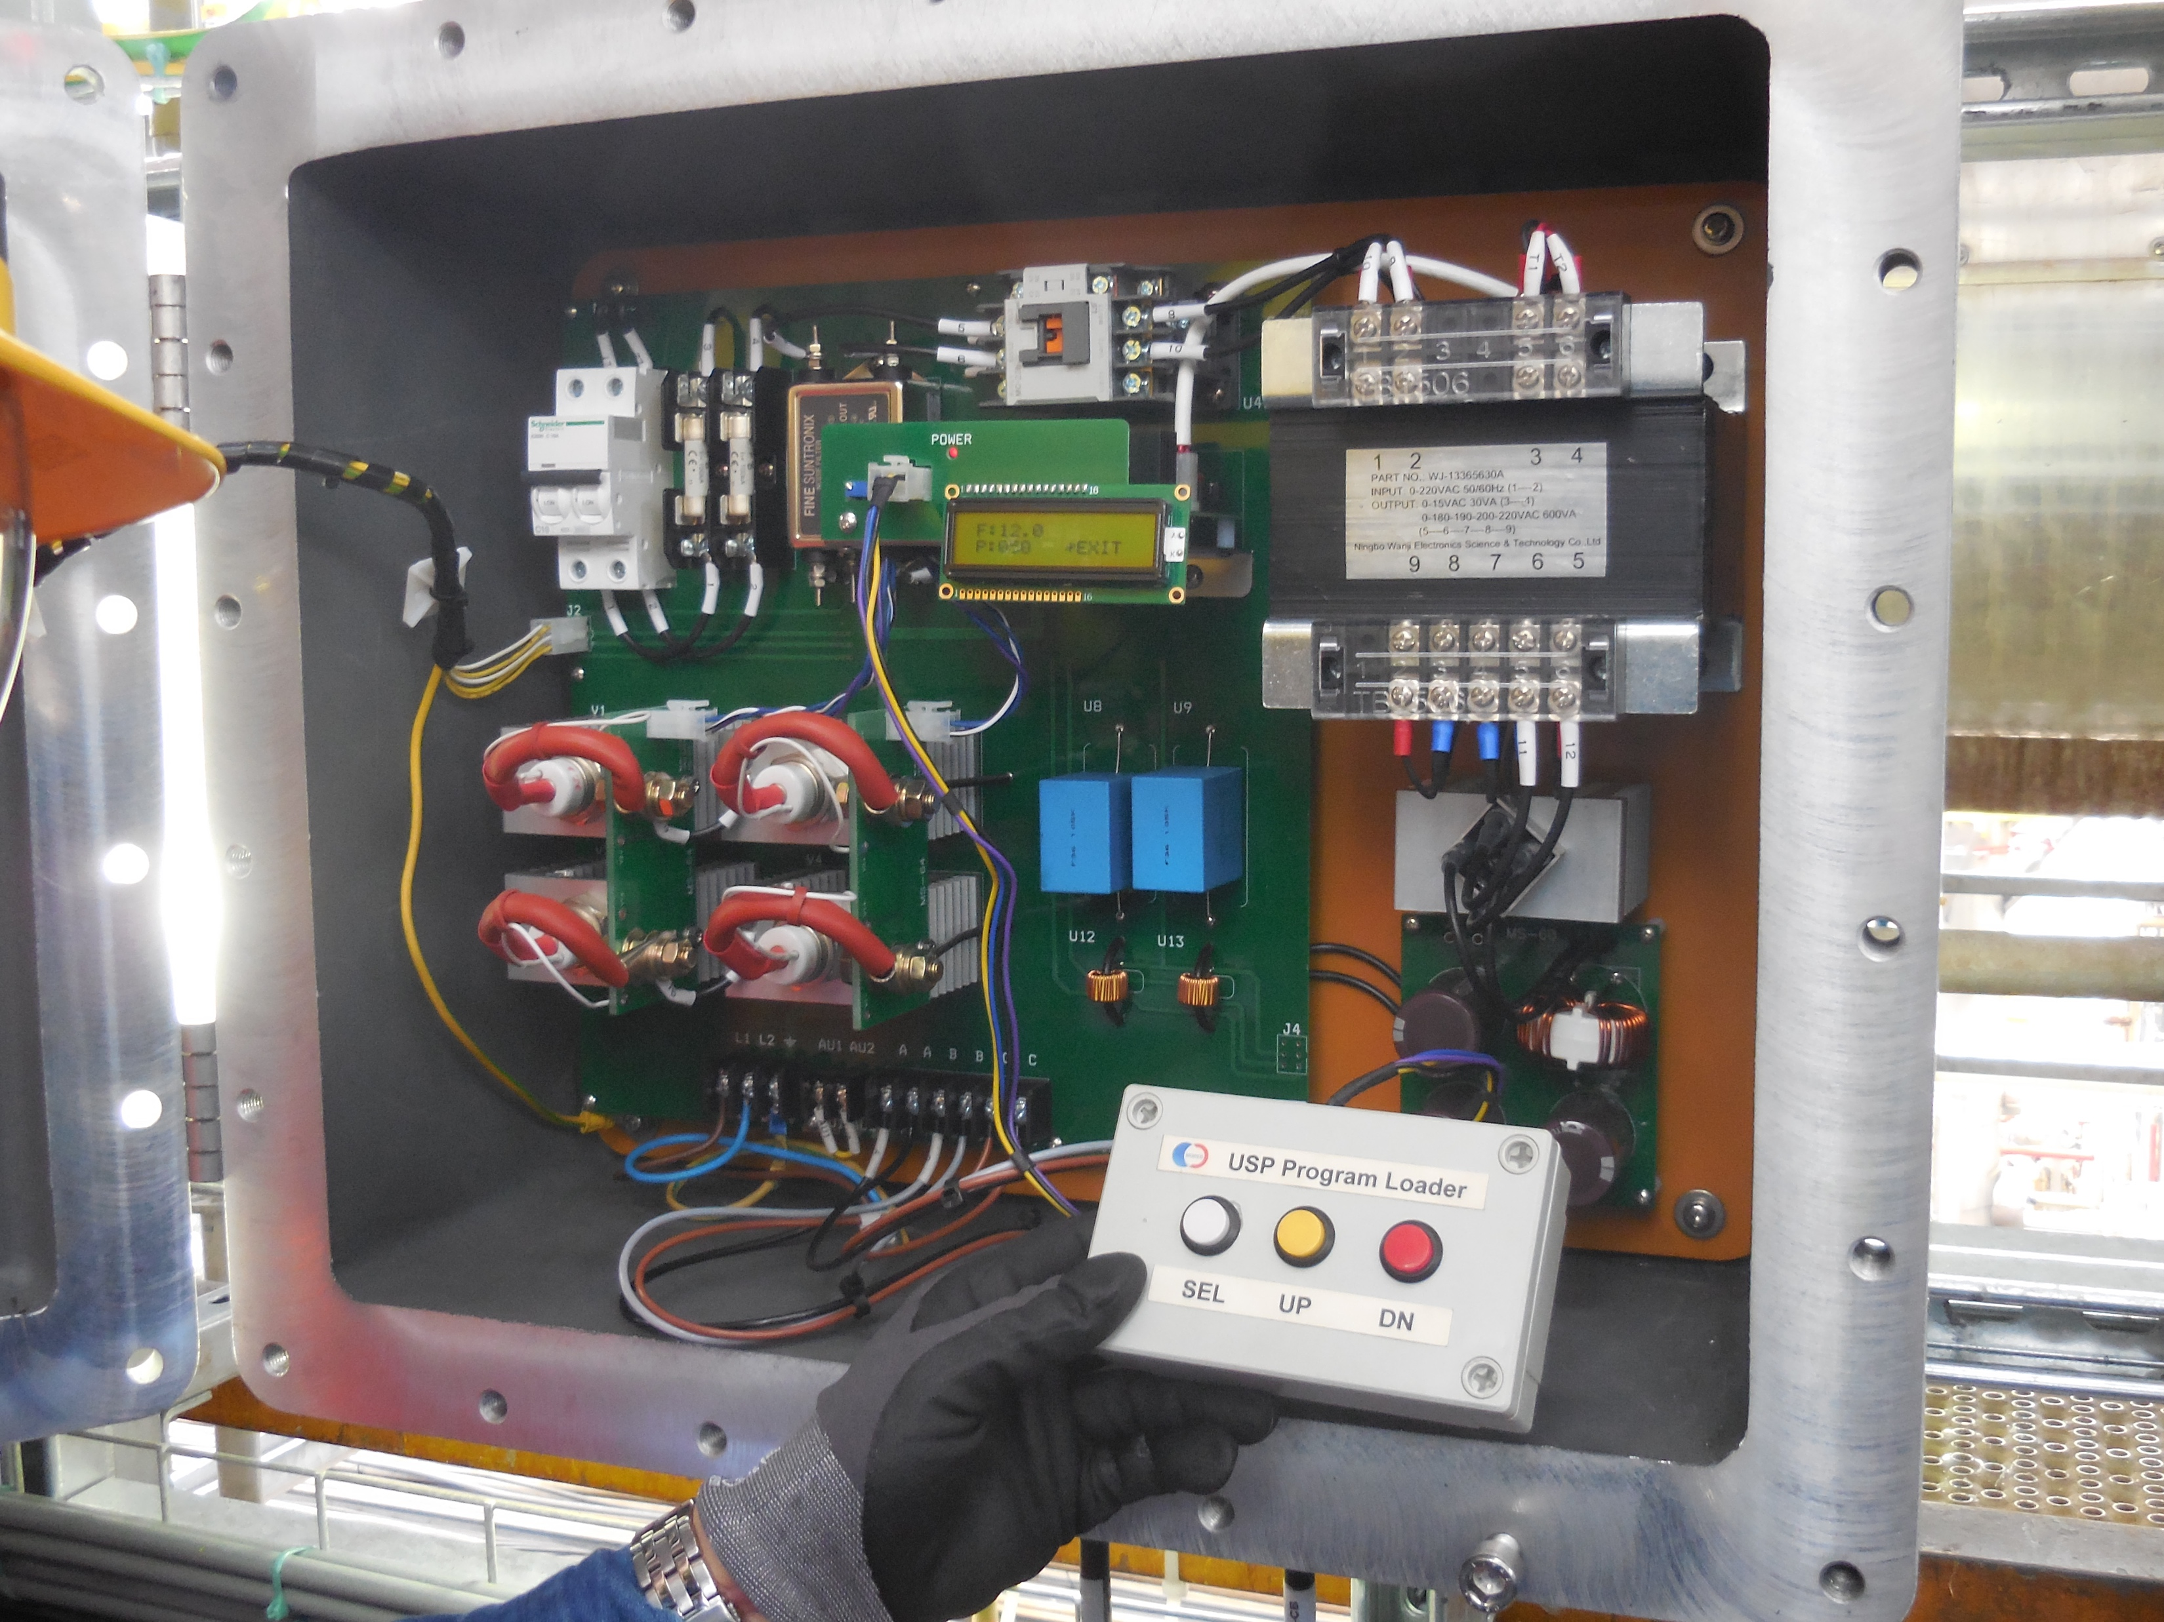
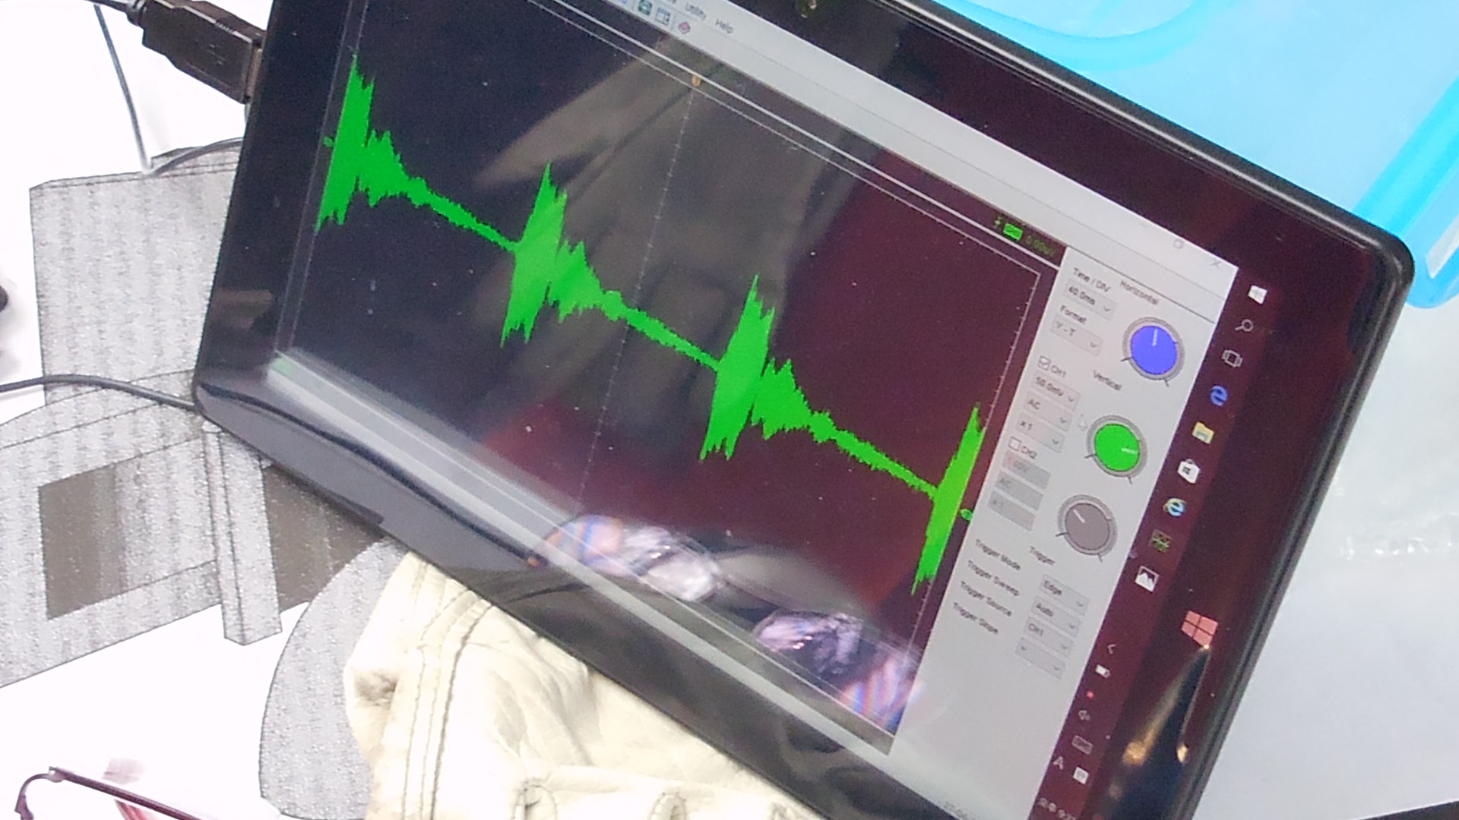
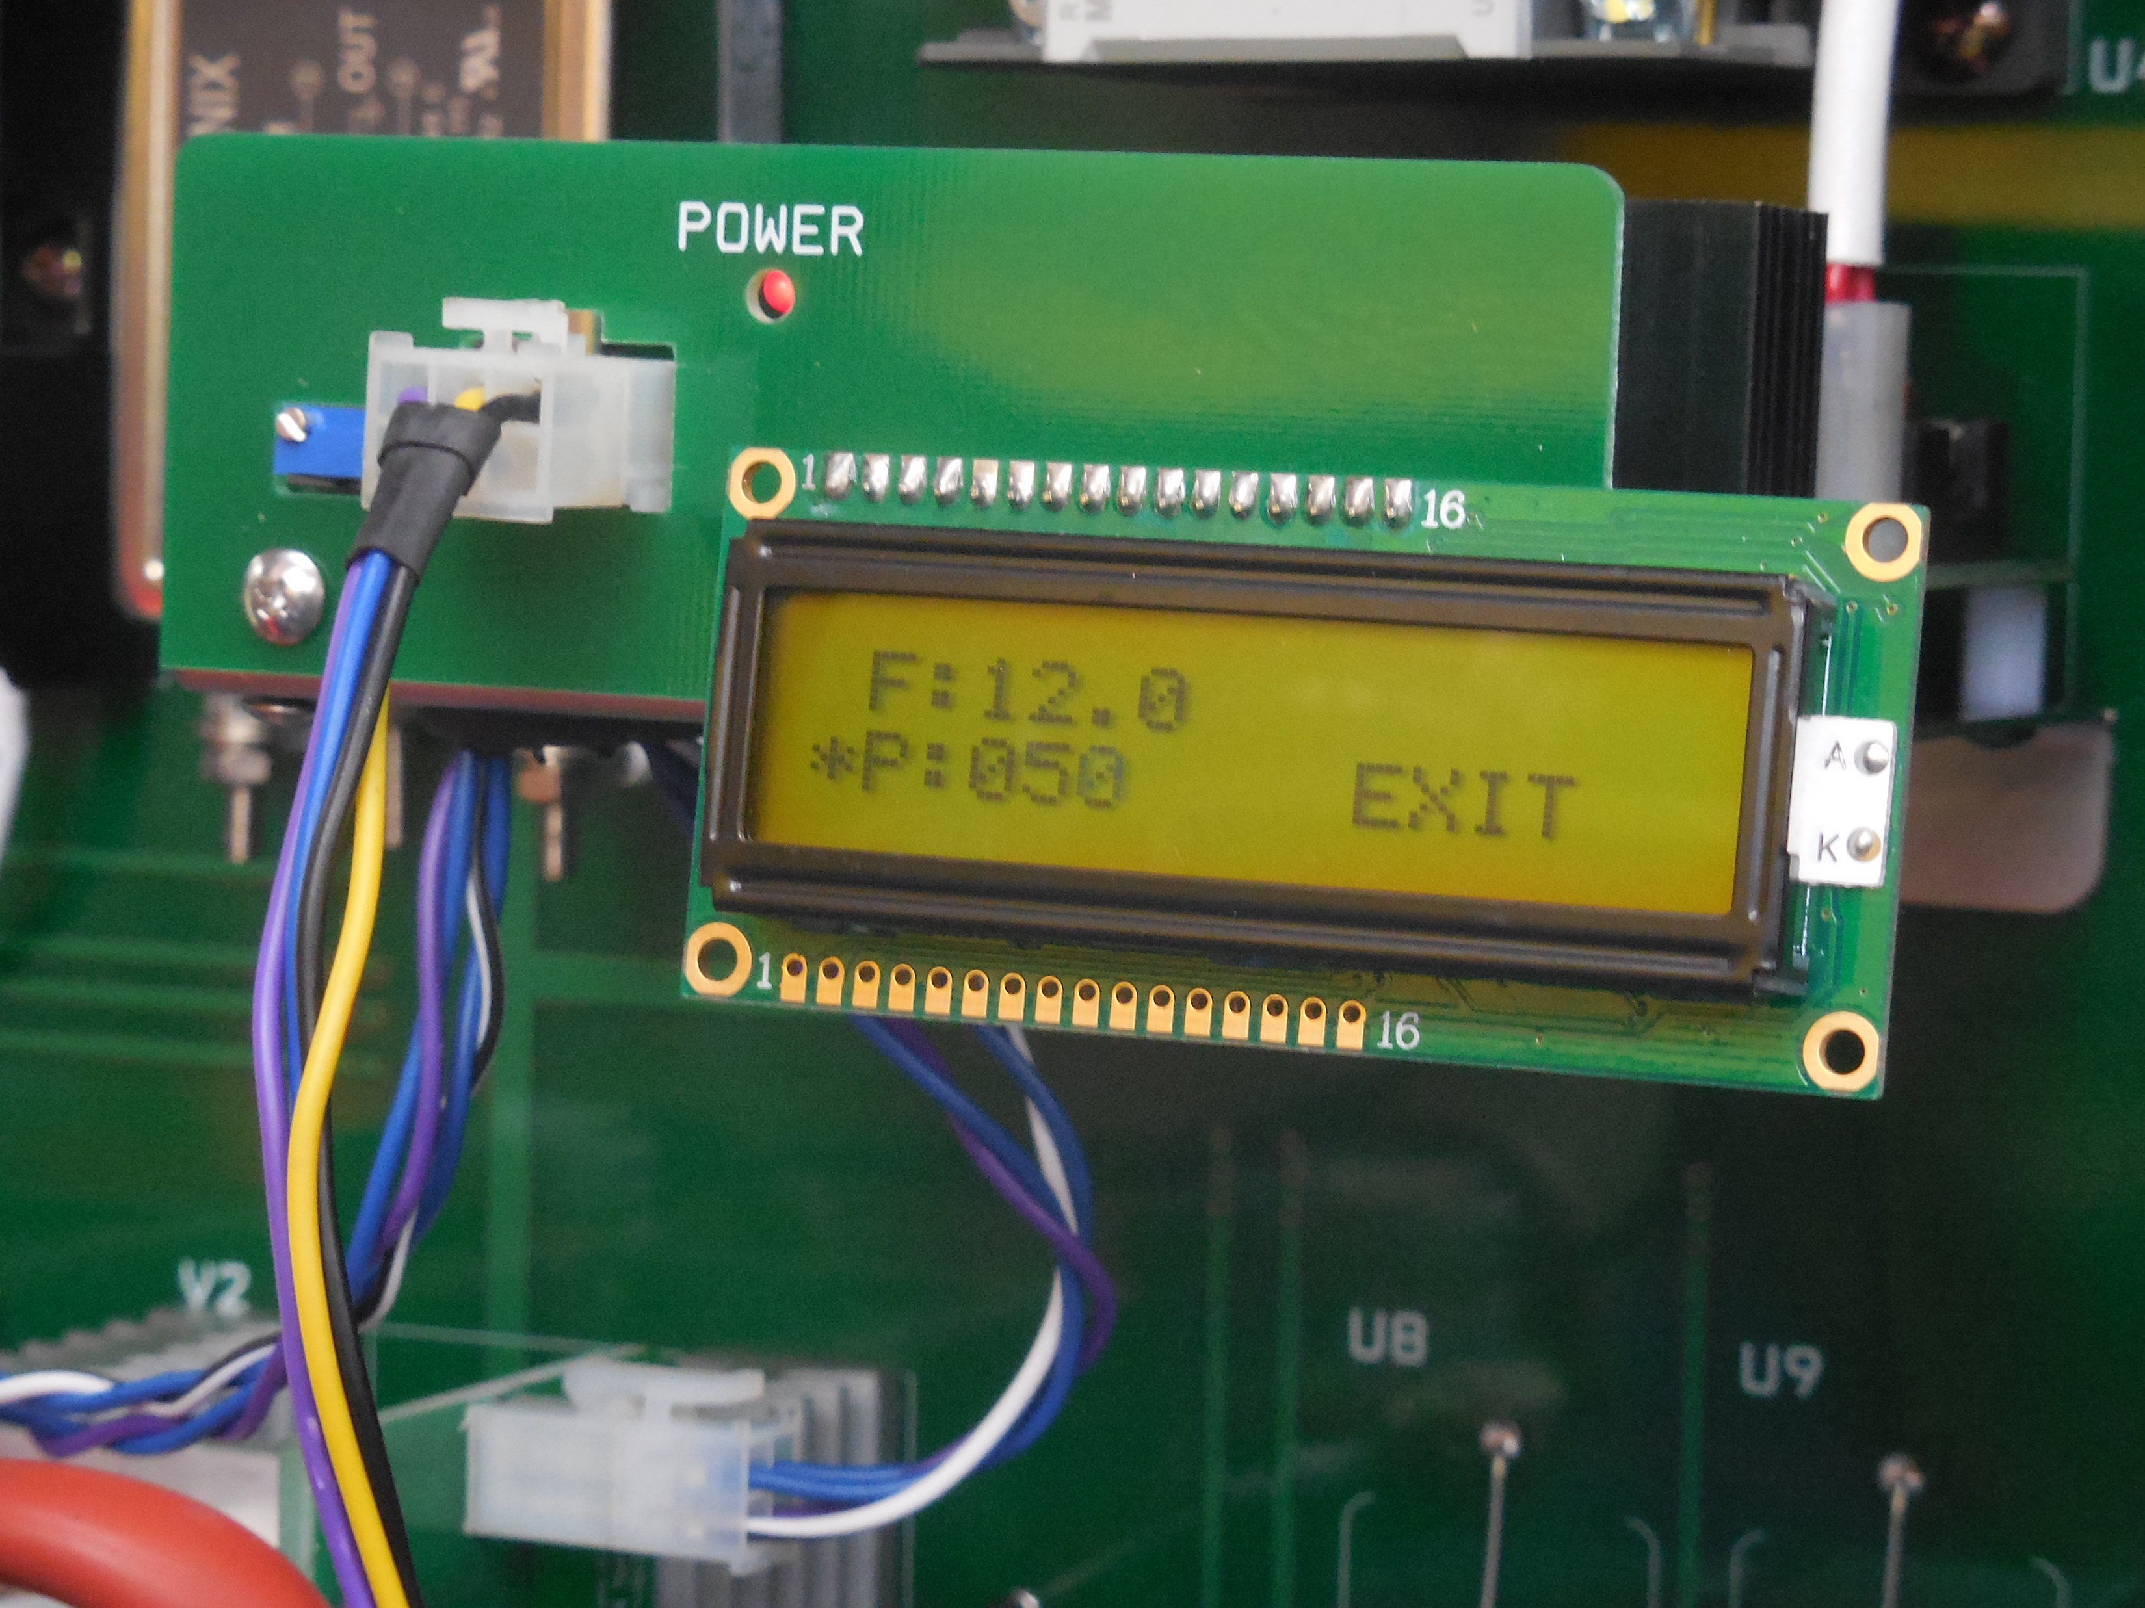
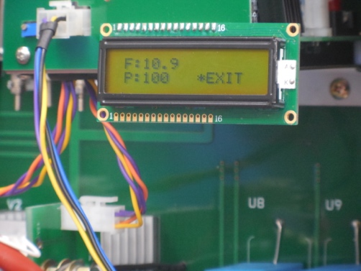
Commissioning & Calibration
Generators provide pulsed-power from 30-100 ultrasonic micro-pulses p/s. The setting is based on certain characteristics of the flowing media: type, viscosity, temperature, flow-rate.
The systems are configured under: UL,CE and ATEX certifications.
Division Classification I, II, ??:
220Vac 60 Hz
230/240Vac 50 Hz

Slide 16
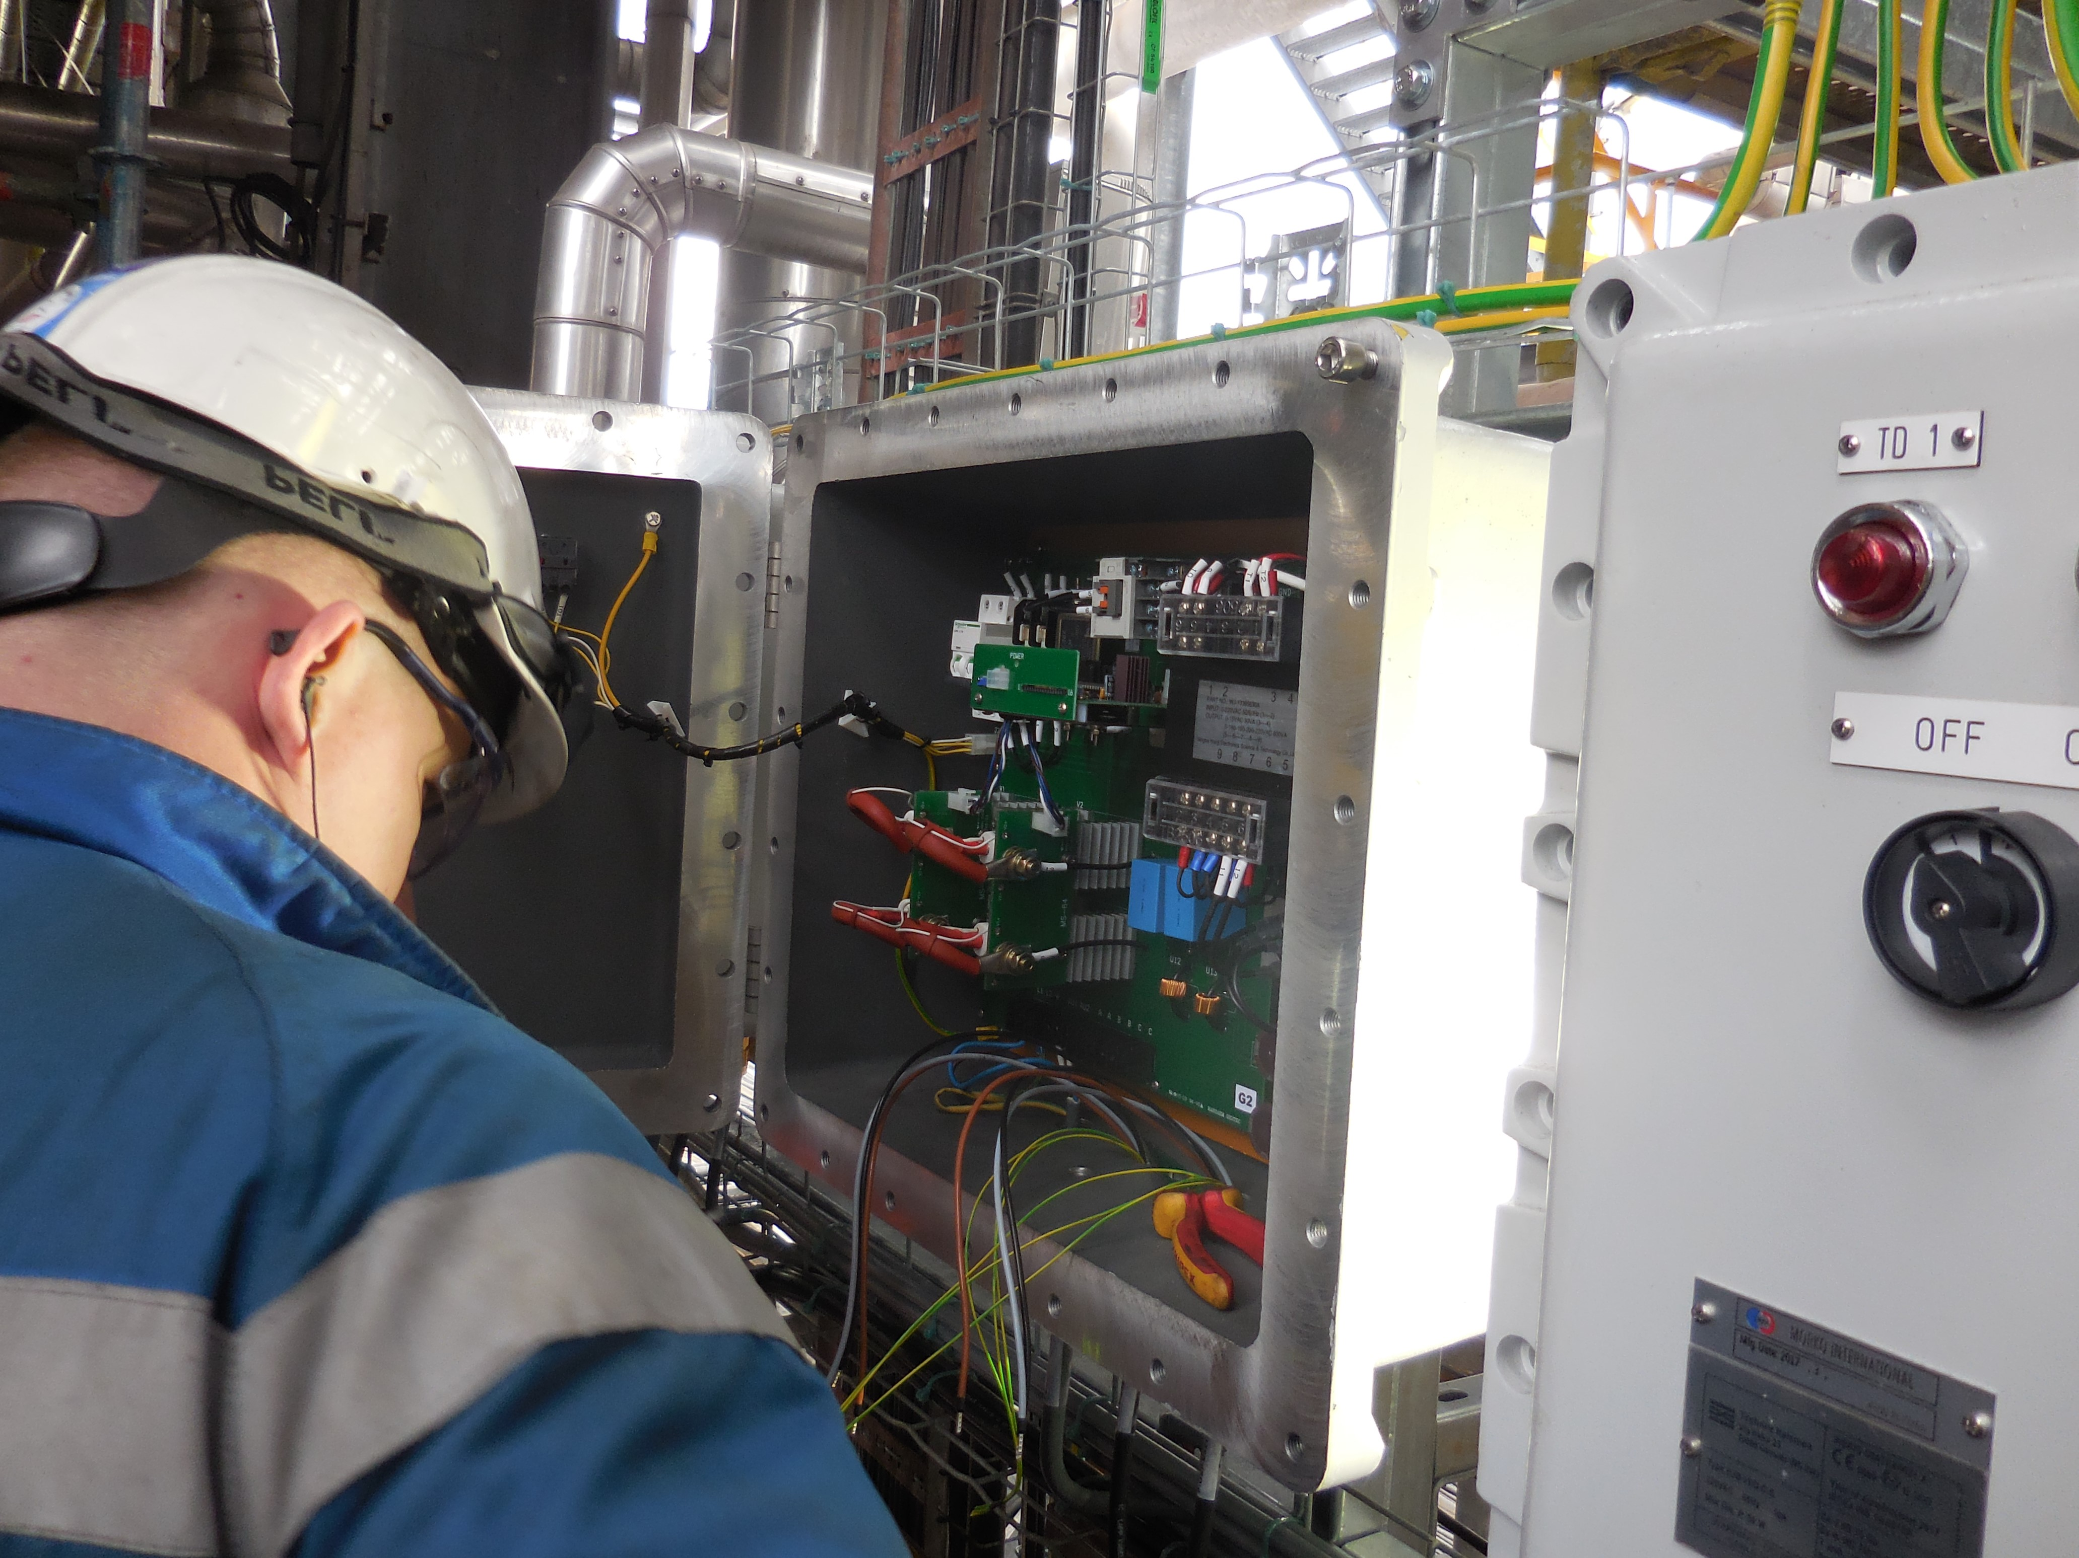
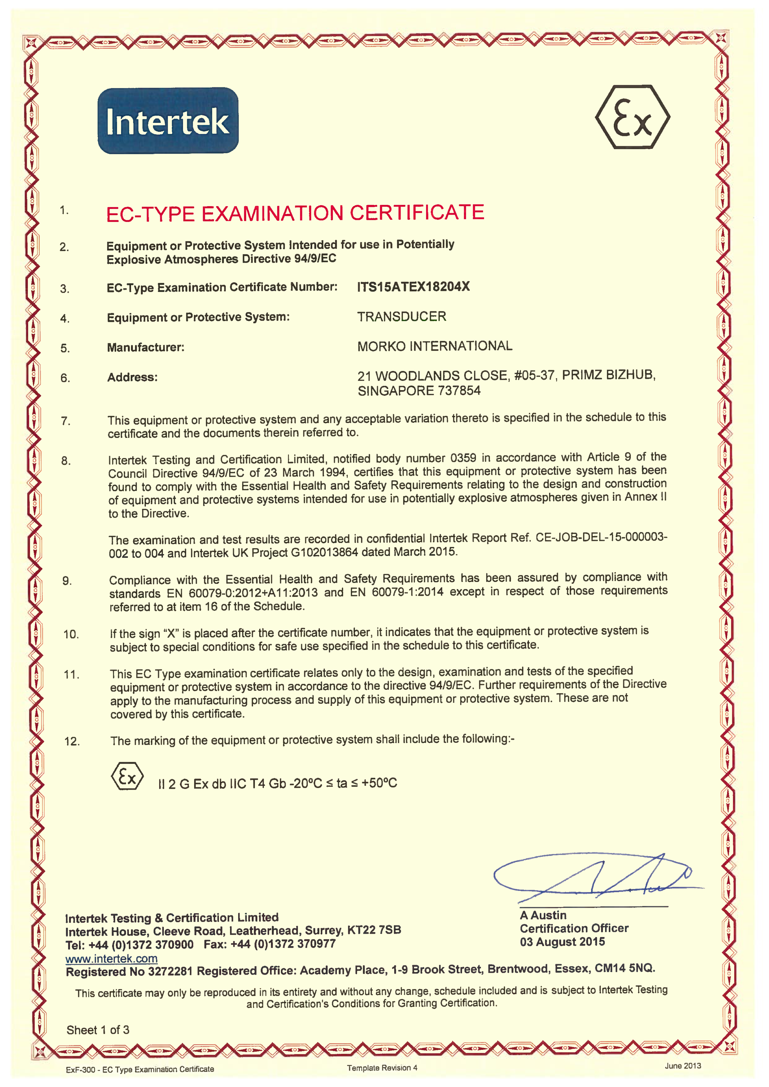
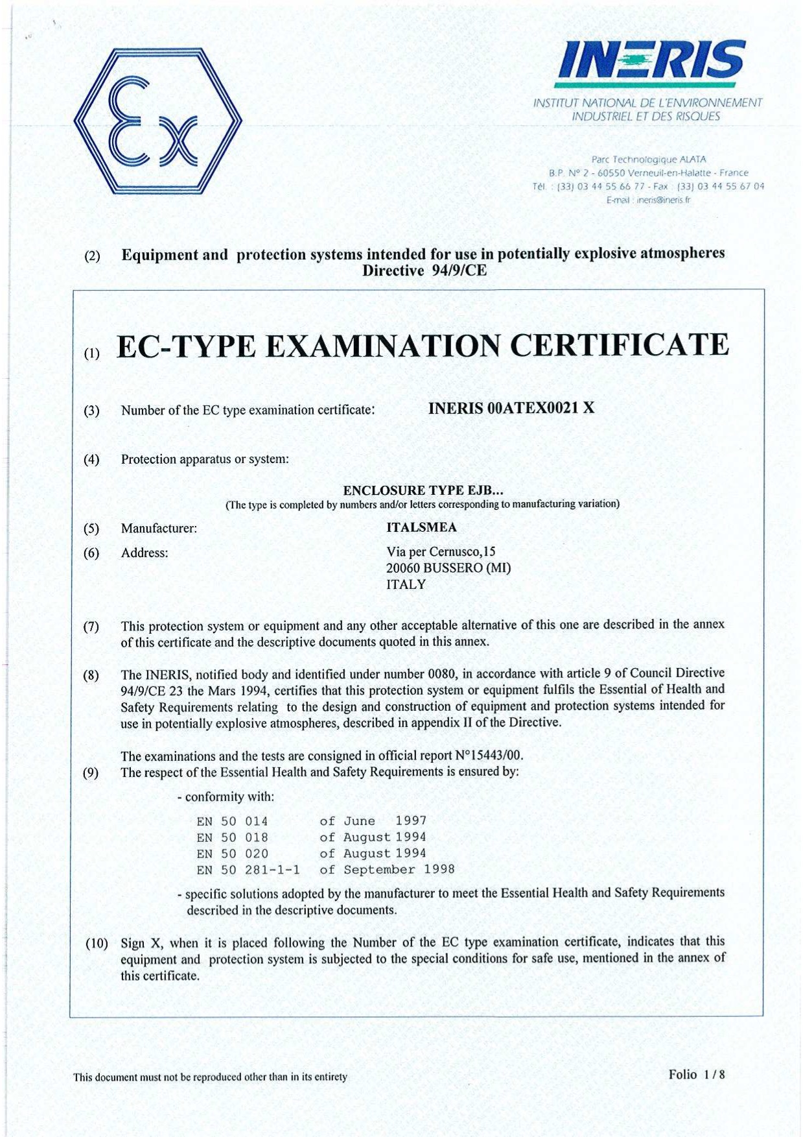
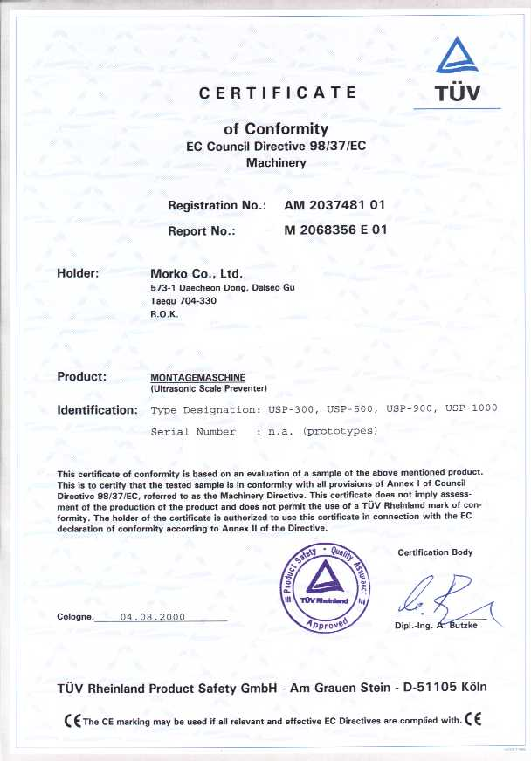
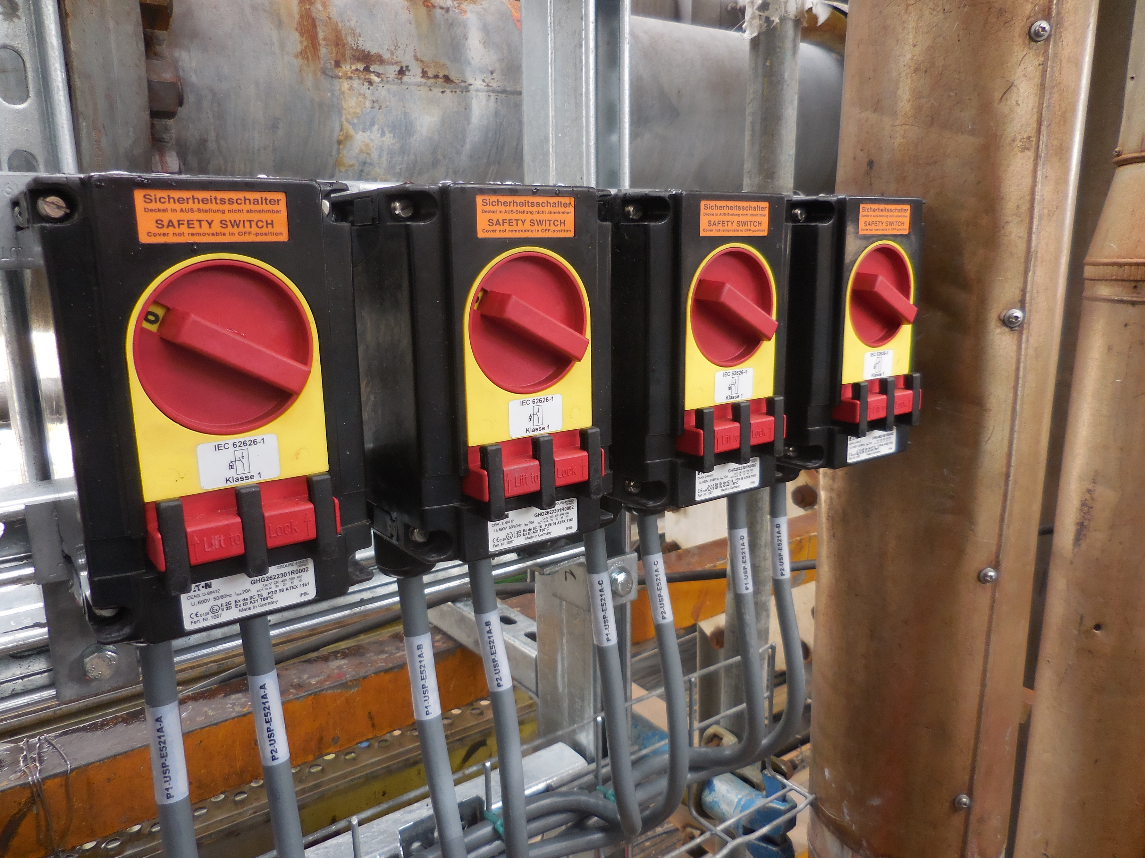
Certifications
The systems are configured under: UL,CE and ATEX certifications.
Division Classification 1
220Vac 60 Hz
230/240Vac 50 Hz

Slide 17
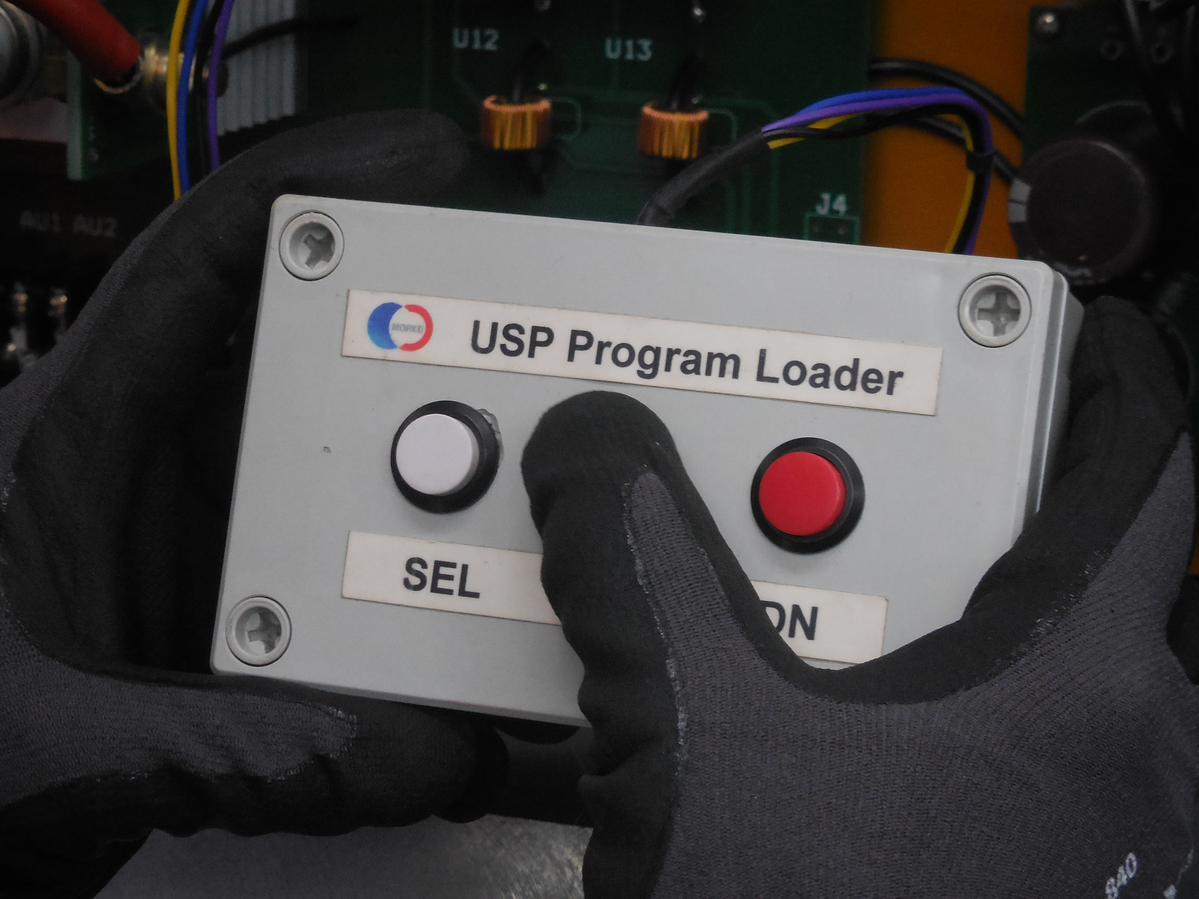
USP Generators
Generators provide pulsed-power from 30-100 ultrasonic micro-pulses p/s. The setting is based on certain characteristics of the flowing media: type, viscosity, temperature, flow-rate.
The systems are configured under: UL,CE and ATEX certifications.
Division Classification I, II, ??:
220Vac 60 Hz
230/240Vac 50 Hz

Slide 18
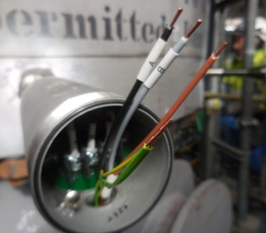
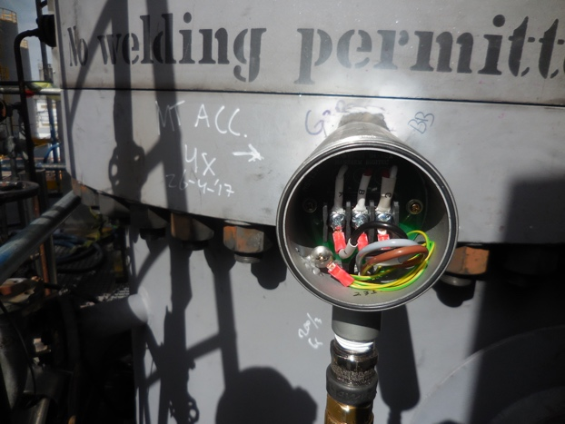
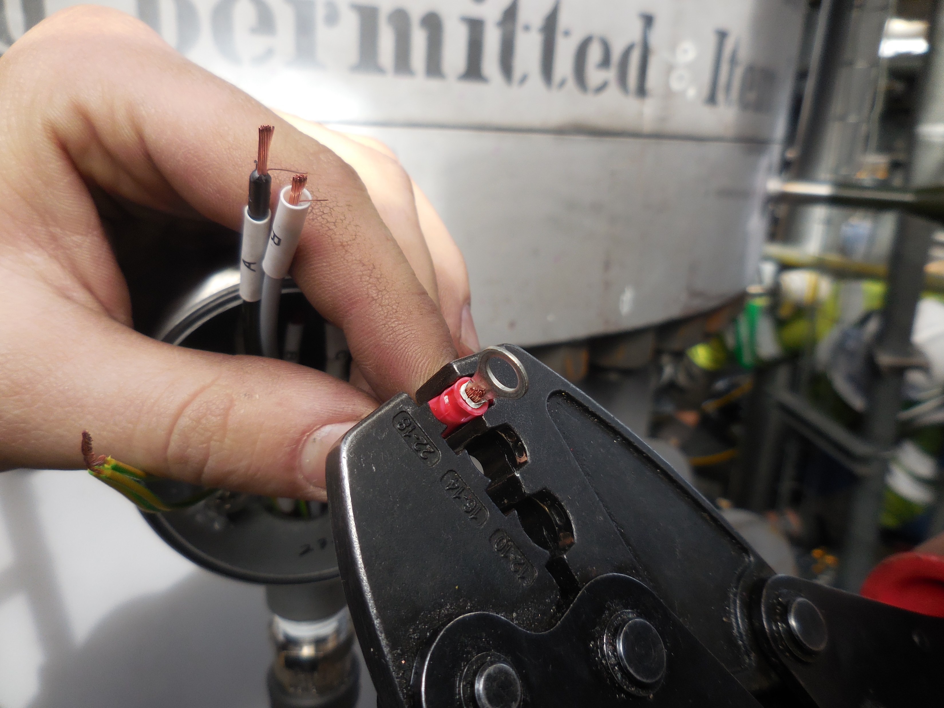
Commissioning & Calibration
System Commissioning and transducer calibration for optimizing US cavitation and vibration
Testing

Slide 19
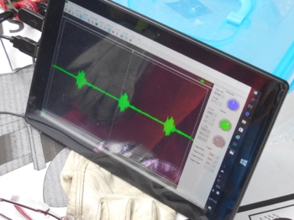
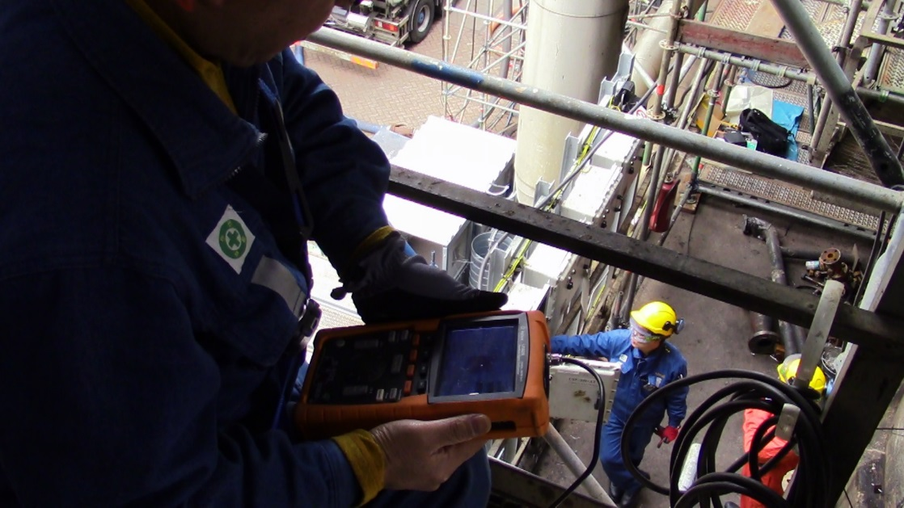

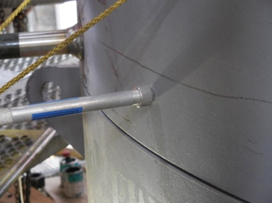
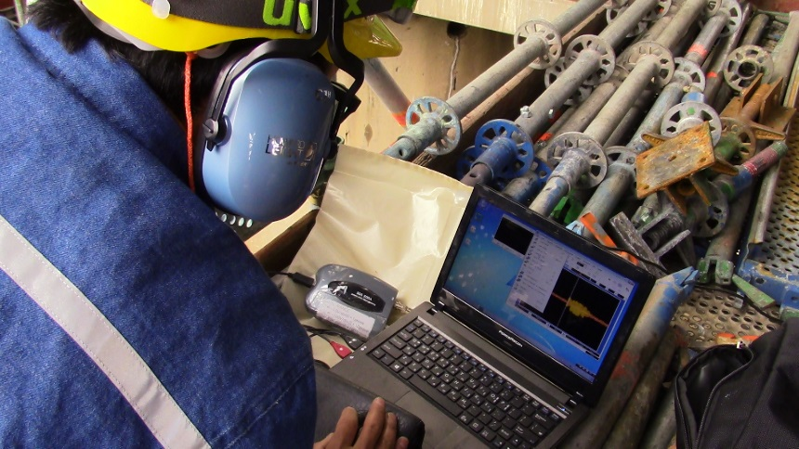
System Calibration
System Commissioning and transducer calibration for optimizing US cavitation and vibration
Testing

Slide 20
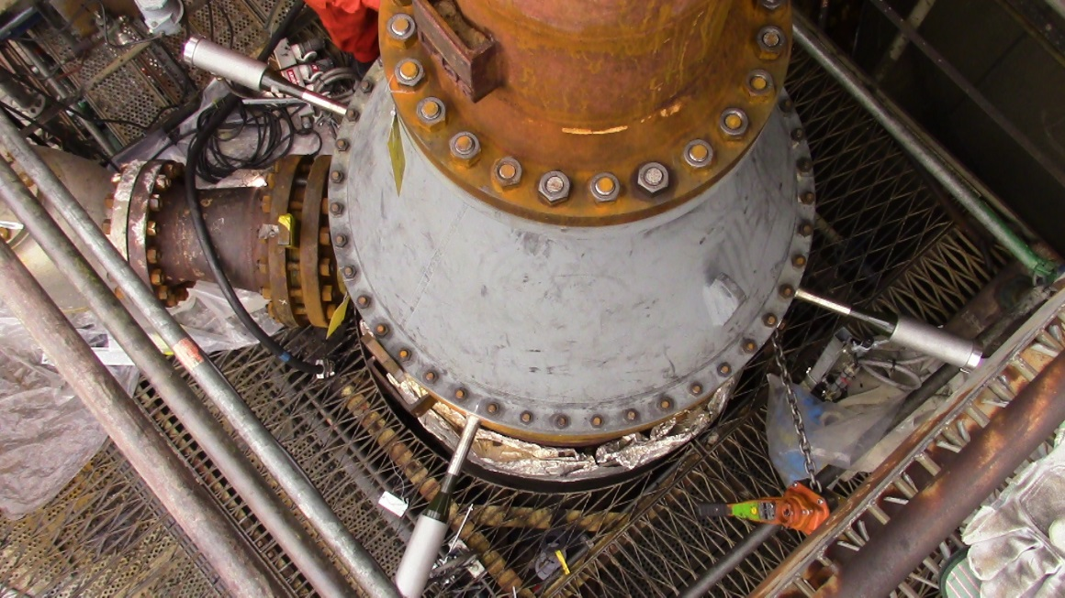
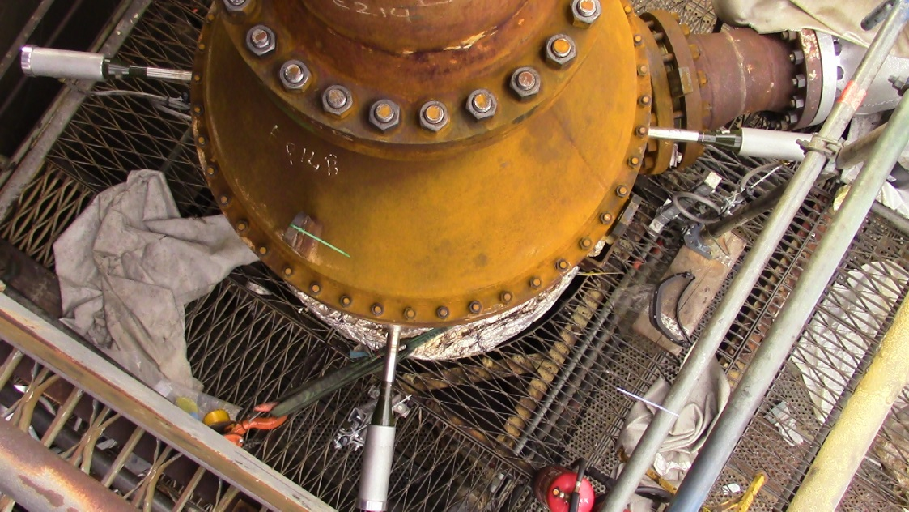
Global Installations
Royal Dutch Shell, Pernis, NL
CD-6: 214 A/B
4 USP Transducers per heat exchanger.
Data from this first USP installation was captured utilizing the Smart Perform™ monitoring application. The application identified the initial USP successes and followed the performance for the year and beyond.
214A
214B
Notes:
Before we applied USP we had to perform an online cleaning every 6-8 weeks by flushing with gasoline and steaming out the exchanger. Various chemical cleaning options have been tried, however none of it were successful. Every 2 to 3 years we had to apply a mechanical cleaning and stop the unit for a couple of days, in case there was no turnaround planned. The intent of USP was to limit the number of online and avoid any mechanical cleanings between turnarounds. We just started the 3rd year with USP and things still look good. We did not apply any online cleaning yet and are still running at the desired 8MW.
2: Attached. Please keep the graphs for yourself and do not distribute it to others.
3: see answer on question 2. Note this is a bit different calculation, but the overall results point in the same direction as the earlier calculations by SmartPerform.
4: In the first 3 months of 2016 we used at CD6 the same crude diet as we use in CD5. We found out that the E214 reboilers started fouling, although the earlier operation with USP showed hardly any fouling build up. This made us conclude that USP is not the best option to apply at CD5, at least we would need to perform mechanical cleanings between turnaround periods. We decided to buy a spare set of bundles which we can quickly exchange (in order to limit downtime) and not apply USP.

Slide 21
USE: S-OIL, SK, GS Caltex, PTT,
DOW Tern, Deer Park, USA
214A
214B

Slide 26
Here is what this really means….
An investment of $280k by Shell for this solution, provided them with an energy savings of 1.4M in year one.
Cost avoidance- not having to stop and clean: equipment, manpower, fuel, water and waste remediation resources.
Process Opportunity Gain: What’s the additional operational revenue gain for not shutting down for a maintenance interval??
Notes:
Here is what I mean when I say the customer ROI numbers are solid, yet we have to be careful how we present the numbers. (can seem too fantastic)

Slide 27
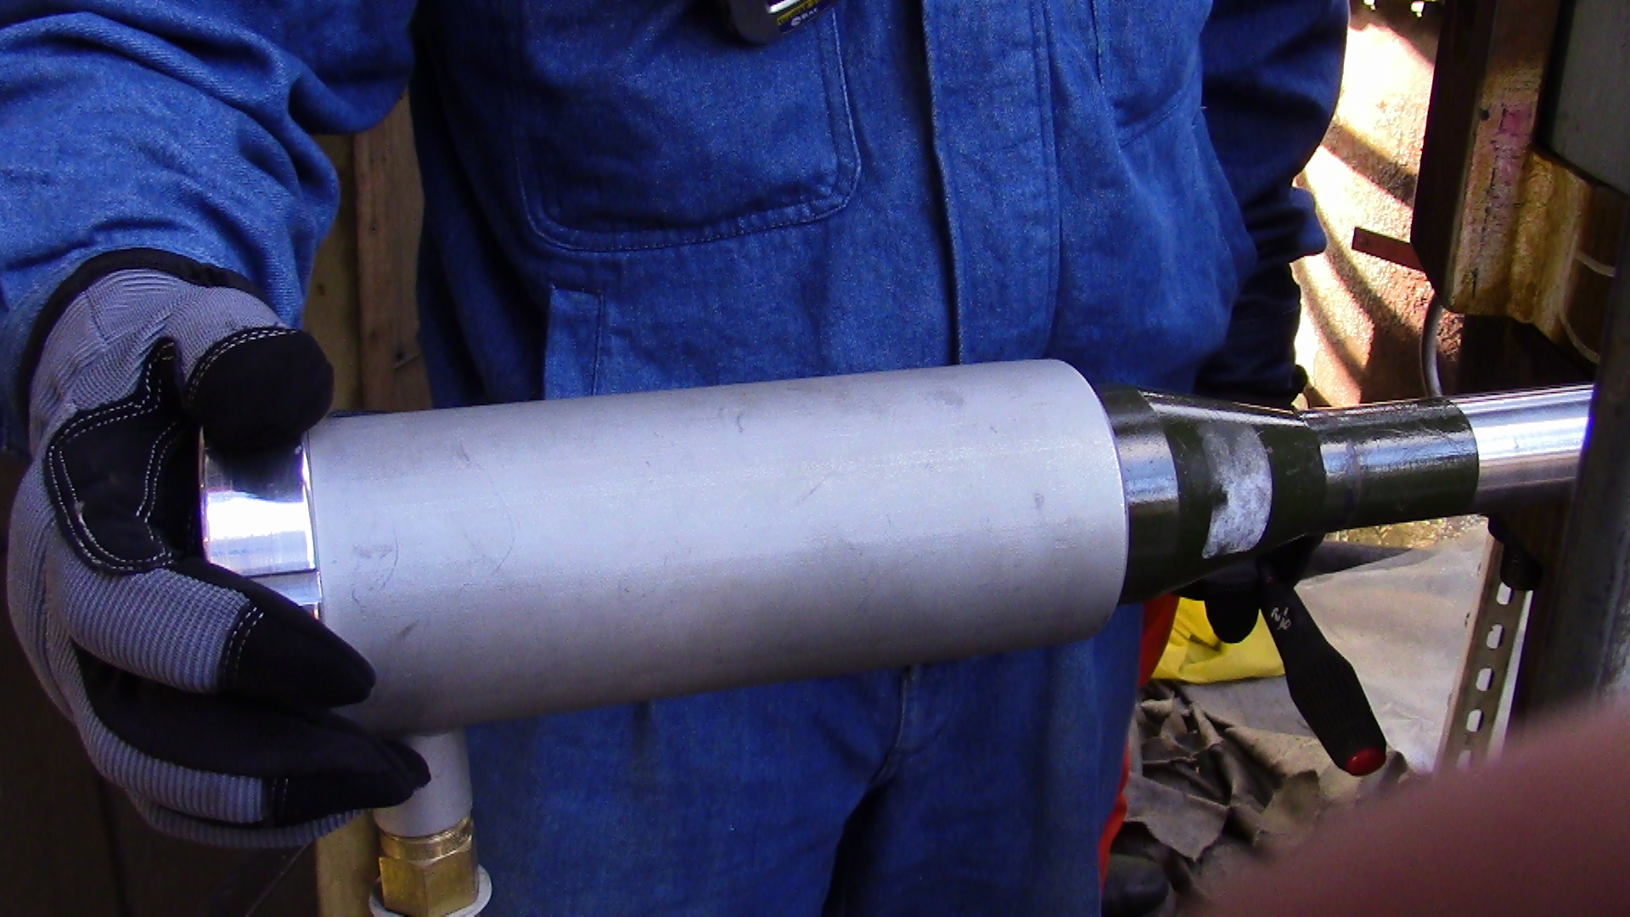


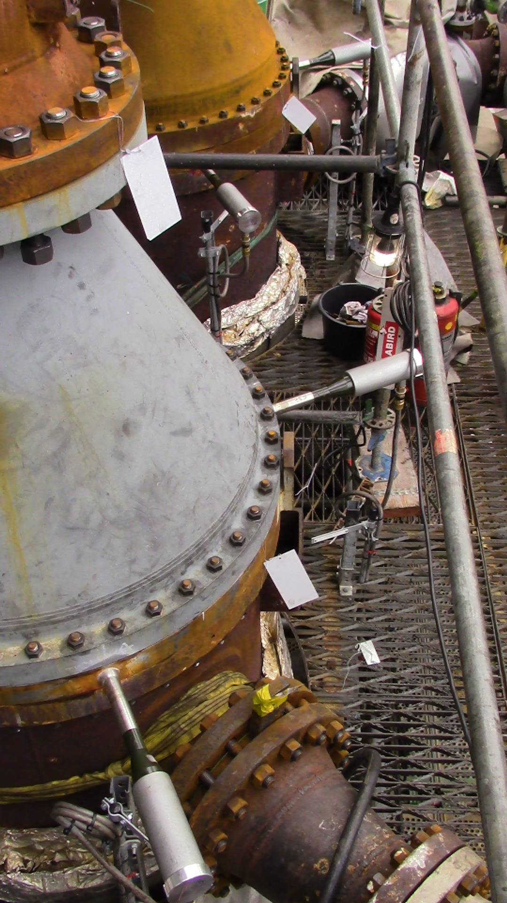
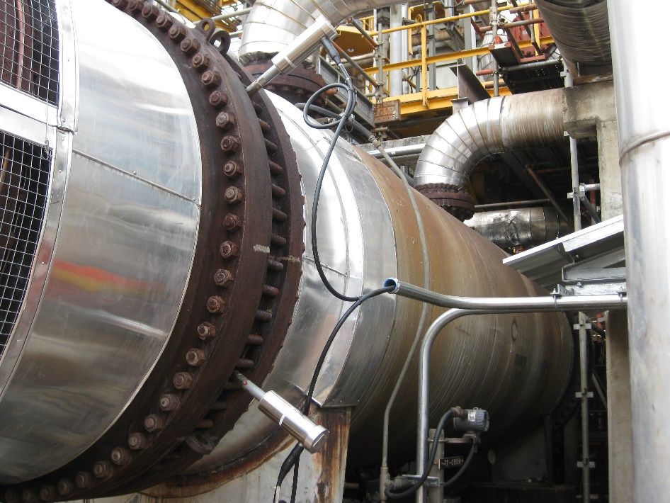
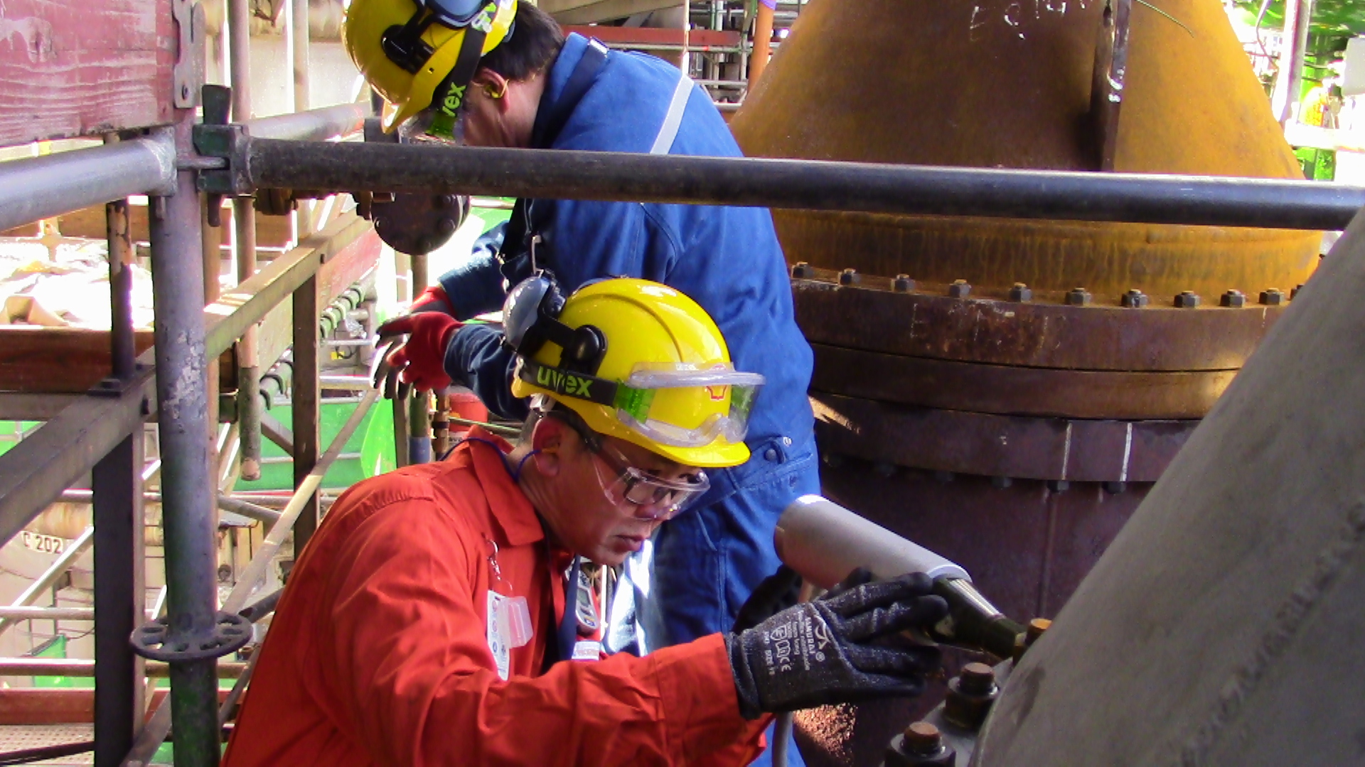
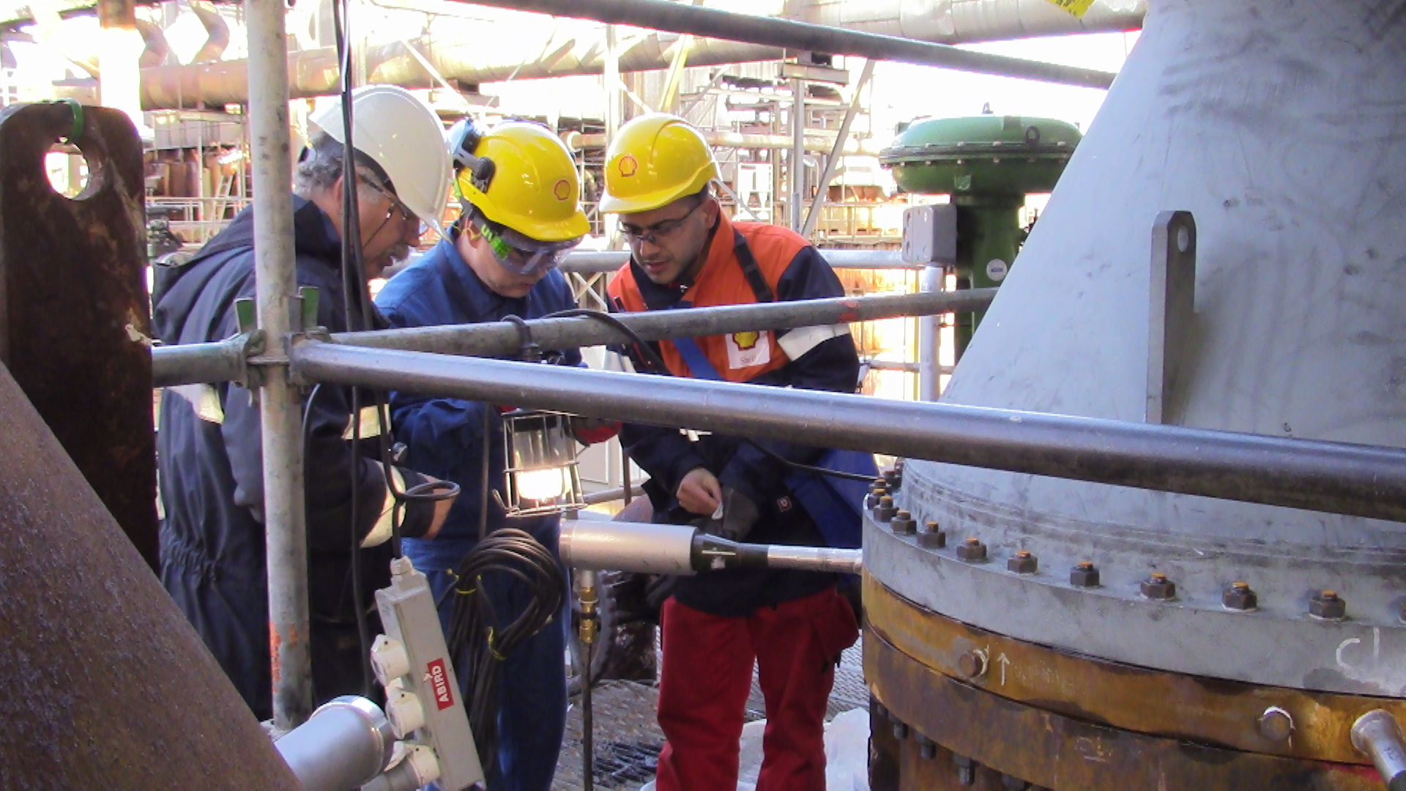
UPTIME— is the key benefit of this technology. The USP system allows your processing units to continue in full operation as cleaning takes place.
The result is greater heat transfer efficiency and significantly lower operational-energy costs.

Slide 28
UPTIME— is the key benefit of this technology. The USP system allows your processing units to continue in full operation as cleaning takes place.
The result is greater heat transfer efficiency and significantly lower operational-energy costs.

Slide 29
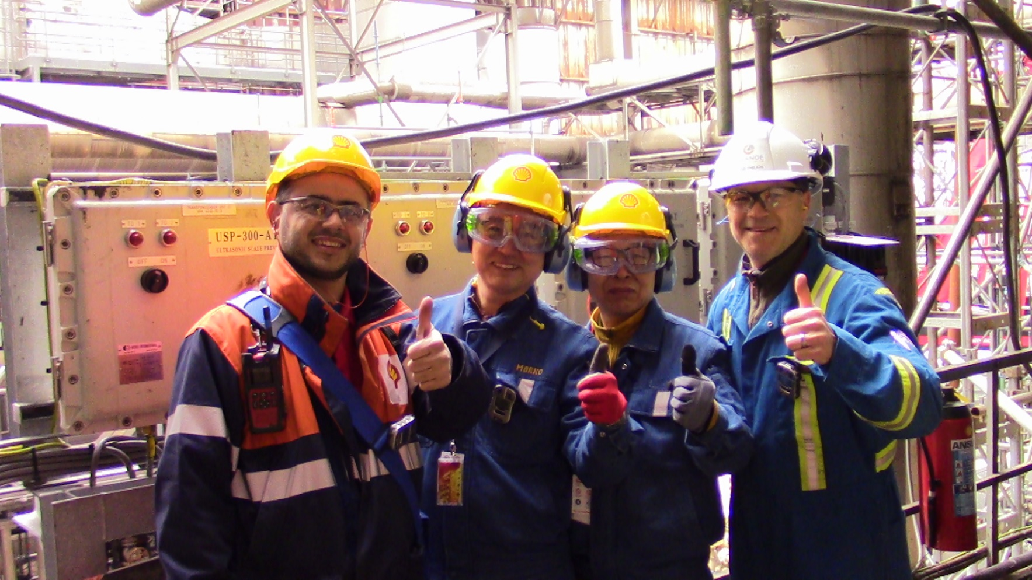
CD-6: Hx Units: 214 A/B
Installed April 2015 Ready to go!
April 2016 –No cleaning required
April 2017 –No cleaning required

Slide 30


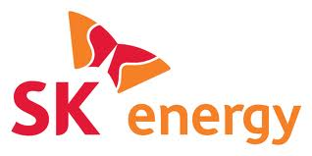









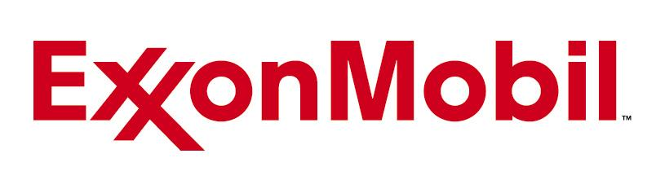

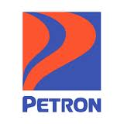

Current Users of USP Technology

Slide 32
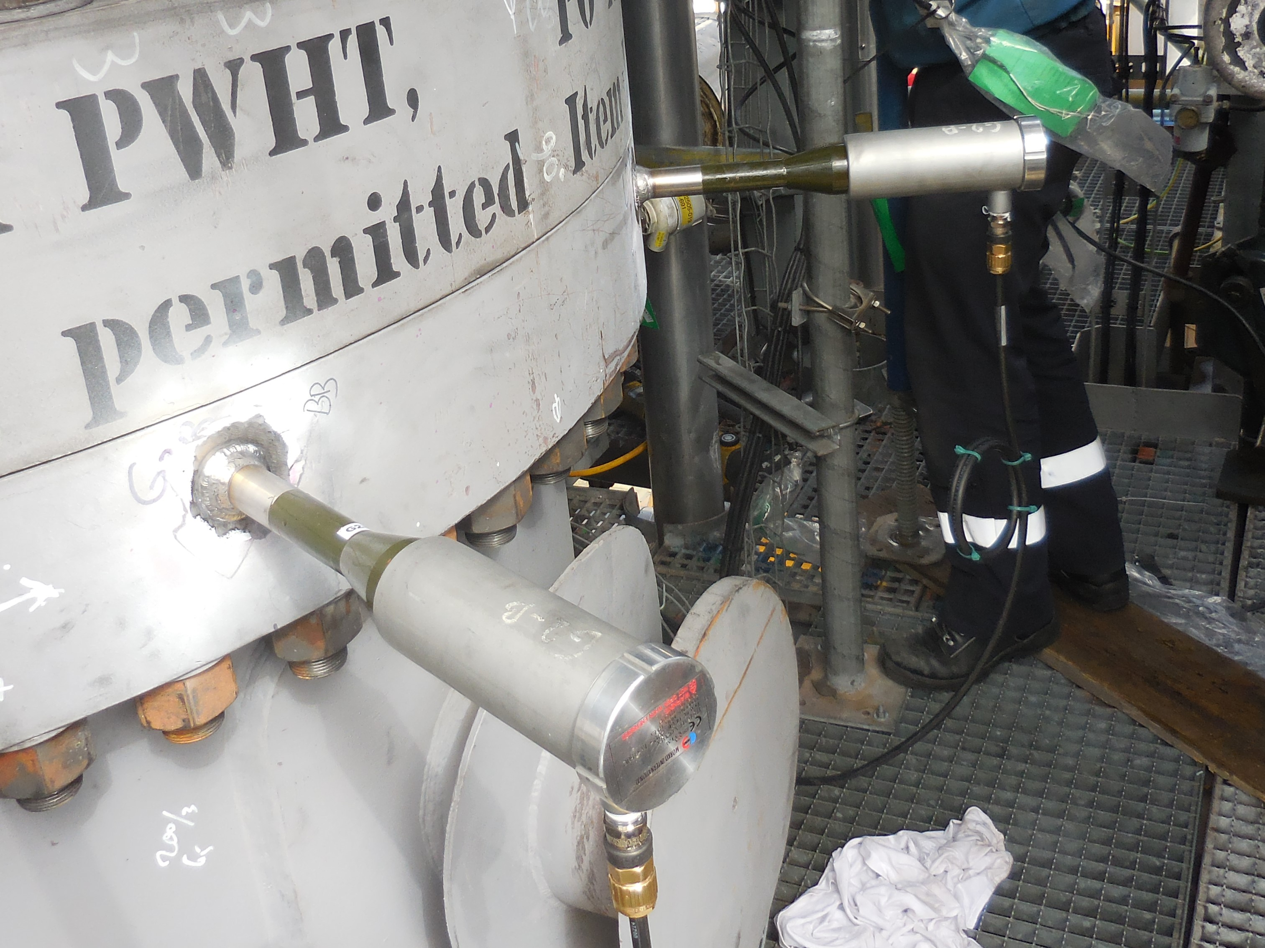

INSTALLATION:
Event outage or T/A

Slide 33
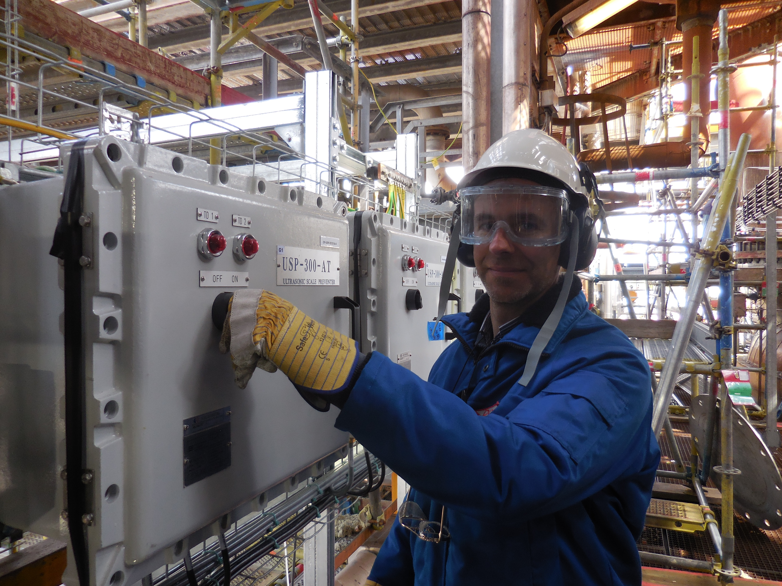
OPERATION:
Turn it on, leave it on.

Slide 34
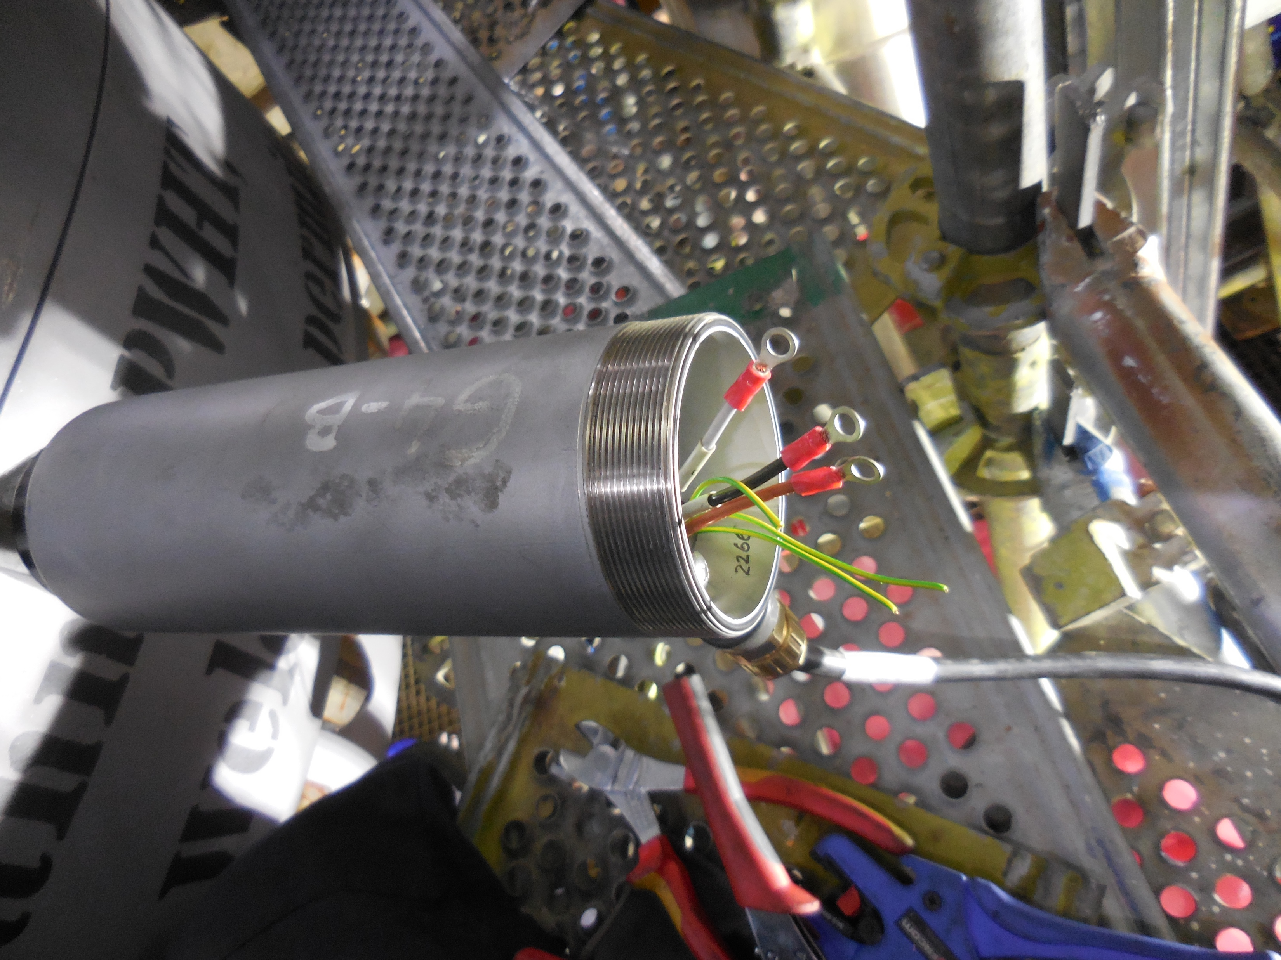
MAINTENANCE:
2 year inspection and part replacement
4 year inspection and parts replacement

Slide 35
FAQ’s
Sound emitted
Vibration, concerns,
Installation Window
Operational know how
Lifespan/Maintanence
Others covered in USP/FAQ Link.

Slide 36
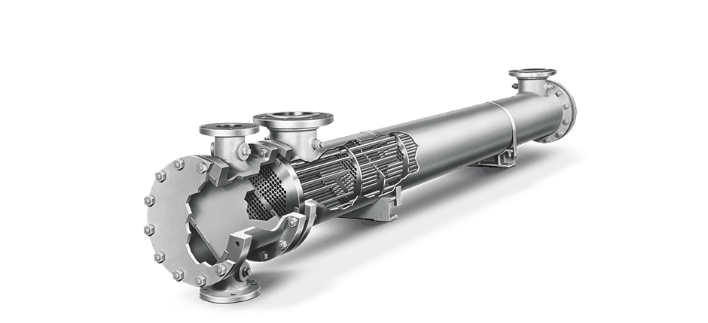
Cost Estimates for USP
Notes:
To better understand how USP or the immersion technologies can best benefit your situations, we really need to know more about the specific processing units you are looking to make more efficient.
Each heat exchanger
This is a heat exchanger. They are in every type of processing plant around the world. They come in different configurations shapes, sizes but perform a similar function for their users.
Oil & Gas, chemical, petrochemical, Electrical power generation, pharmaceutical, HVACR producers, food production and water treatment plants to name a few. They all use some form of these heat transfer assets

Slide 37
Cost Estimates for USP
Factors affecting the budget for a USP system-solution:
Physical dimensions: (Length, Diameter) and
TEMA characteristics of the heat exchanger,
Orientation: Vertical/Horizontal,
Shell/Tubeside: Fouling Media
Notes:
To better understand how USP or the immersion technologies can best benefit your situations, we really need to know more about the specific processing units you are looking to make more efficient.
Each heat exchanger
This is a heat exchanger. They are in every type of processing plant around the world. They come in different configurations shapes, sizes but perform a similar function for their users.
Oil & Gas, chemical, petrochemical, Electrical power generation, pharmaceutical, HVACR producers, food production and water treatment plants to name a few. They all use some form of these heat transfer assets

Slide 38


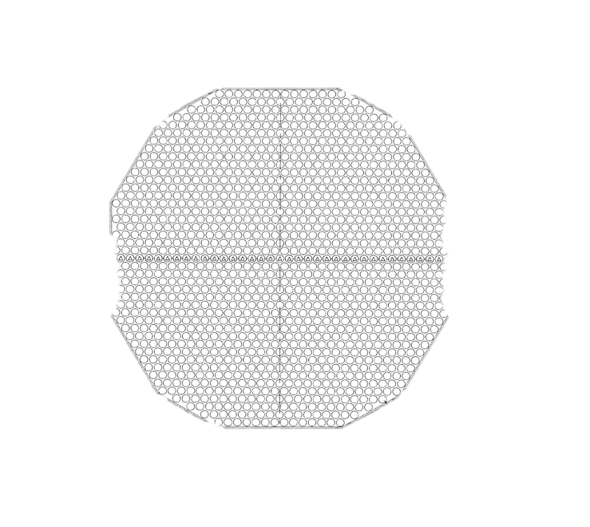

Cost Estimates for USP
Factors affecting the budget for a USP system-solution:
How many sets (2 Transducers/1 Generator = 1 set) would be required for proper fouling mitigation?
Each set requires an investment of $85K USD
HEAT EXCHANGER
TUBESHEET
INLET
Notes:
To better understand how USP or the immersion technologies can best benefit your situations, we really need to know more about the specific processing units you are looking to make more efficient.
Each heat exchanger
This is a heat exchanger. They are in every type of processing plant around the world. They come in different configurations shapes, sizes but perform a similar function for their users.
Oil & Gas, chemical, petrochemical, Electrical power generation, pharmaceutical, HVACR producers, food production and water treatment plants to name a few. They all use some form of these heat transfer assets

Slide 39
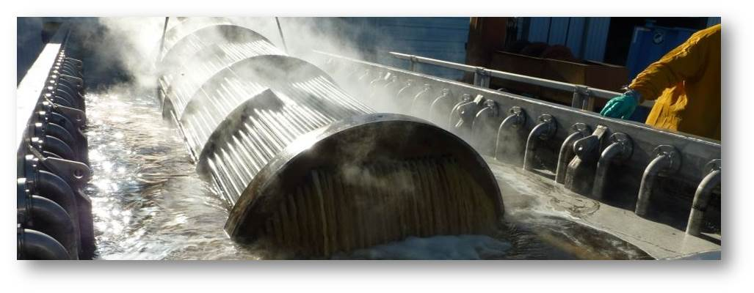

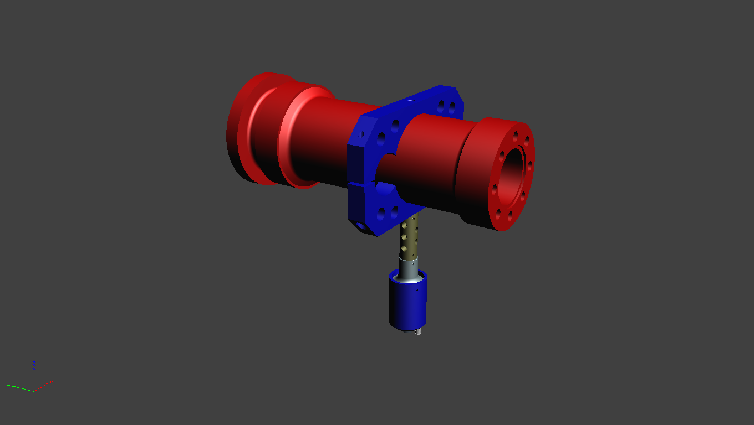
Ultrasonic Cleaning Baths
Multiple sizes & configurations
Variable powered units for purpose-built cleaning applications
Clean-in-Process Technologies
  USP [Ultrasonic Scale Prevention]
  M³ Technology
Fouling Mitigation & Process Improvement
  M³ Technology (clamp on) apparatus with pre-selected ultrasonic power output, to match with specified outcomes
  Ultrasonic Pigging Train
Notes:
While the ultrasonic bath provides a step change to process improvement, greener overall result, Clean in process technologies, are the disruptive technologies that will change how processing industries in the near future manage critical assets on site.

Slide 40

Presentation By:
Russell Philion
CTO,
For additional information on this or other cases, contact us at the information below:
Email: russ@orangeultrasonics.com
Direct: 1-416.779.8262
Notes:
Thanks for your time….
While this has been a very brief presentation of the USP tech, there are other case studies/results that we can share with you when we have an NDA in place between our two companies.
Additionally, we have empirical date on cleaning results for the immersion US cleaning tanks.
To better understand how USP or the immersion technologies can best benefit your situations, we really need to know more about the specific processing units you are looking to make more efficient.

Slide 42
russ@orangeultrasonics.com
Notes:
Here are some of the Companies currently benefiting from the USP technology. ANY QUESTIONS FROM THE GROUP TO THIS POINT ?

Slide 43
CD-6 Shell Pernis, (Rotterdam) April 2015
Heat exchangers 214 A/B have severe fouling issues.
A dedicated USP system consisting of mount on transducers and ultrasonic generators provide pulsed-power to remove existing fouling and inhibit new fouling from forming on the heat transfer surfaces.
The systems is: CE,UL and/or ATEX certified
Notes:
This next sequence of slides demonstrate the typical installation and calibration process for USP.

Slide 44


Notes:
Dirty heat exchangers are not an insignificant issue: running these units inefficiently has an environmental impact; due to the additional energy consumption required to produce the throughput required by processors to make their products.

Slide 45
Heat Exchanger
The market size of heat exchanger manufacturing is estimated to grow from USD 12.94 Billion in 2016 to USD 19.14 Billion by 2021, at a CAGR of 8.2%. Market Watch
Notes:
Compound Annual Growth Rate

Slide 46


Notes:
Conventional cleaning methods employ ultra high pressure water blasting that can be dangerous to both the operators and the equipment, environmentally wasteful and in many cases, will not reach critical areas to clean.
Another method is chemical cleaning: Environmentally not ideal, especially with the disposal of the chemical post cleaning. In most cases it is hazardous to the crew and can be an issue to the metal integrity of the assets being cleaned.

Slide 47
10m Ultrasonic Bath 2016

Slide 48
Average USP Technology (Clean-in-Process) Sale Price: $180k to $280k USD
Customer ROI: Annual Energy Savings
Shell Oil- [Philippines] $1.2M
Shell Oil- [Rotterdam] $1.4M MVP
Shell Oil- [Houston] $680k MVP
ORANGE:
We manage a 40% mark-up and a 31% gross margin on these type of project opportunities
Notes:
For Clean in place technologies:
The average sale to a refinery is between $180,000- $ 280,000US. For Shell Oil in the Philippines, this has generated an annual $1.2 million in energy savings.
Shell in Rotterdam: $1.4M, Shell in Houston, $680K in annual energy savings.
Typically Orange will make a 40% mark-up, 31%Gmargin on this sale.
Ultrasonic Baths: Average selling price $885,000. Our total estimate cost of manufacturing the average unit is $550K
I’m going to leave sales projections for the meantime:
Customer ROI is really solid: The picture can be a little too optimistic and in some cases, we’ve had to tone it back as it seems a little to fantastic, which has had the effect of diminishing our believability/credibility.

Slide 49
Ultrasonic Bath Sale Price:
$885k USD
ORANGE:
Cost of manufacturing the average unit is $550K
Notes:
Ultrasonic Baths: Average selling price $885,000. Our total estimate cost of manufacturing the average unit is $550K
I’m going to leave sales projections for the meantime:
Customer ROI is really solid: The picture can be a little too optimistic and in some cases, we’ve had to tone it back as it seems a little to fantastic, which has had the effect of diminishing our believability/credibility.

Slide 50
CD-6 Shell Pernis, (Rotterdam) April 2015
Heat exchangers 214 A/B have severe fouling issues.
A dedicated USP system consisting of mount on transducers and ultrasonic generators provide pulsed-power to remove existing fouling and inhibit new fouling from forming on the heat transfer surfaces.
The systems is: CE,UL and/or ATEX certified
Notes:
Understanding the market: Here’s a project example that illustrates my point.

Slide 51
Notes:
These are the results. They will mean nothing to you and everything to a potential customer look at this tech.

Slide 52
Notes:
These are the results. They will mean nothing to you and everything to a potential customer look at this tech.

Slide 53
Here is what this really means….
An investment of $280k by Shell for this solution, provided them with an energy savings of $1.4M in year one.

Slide 54
UPTIME— is the key benefit of this technology. The USP system allows your processing units to continue in full operation as cleaning takes place.
Notes:
While the performance and energy savings have been significant, what we here over and over again is that when you are looking at the overall picture UPTIME is the overarching benefit of the USP technology.
We understand exactly how to position this to market as we understand what both the key decision makers and the influencers are looking to gain from our tech.

Slide 55
Go-to-Market Approach
Cooperative agreements with 3rd party organizations that have relationships with our key audiences.
  HTRI [Houston/Europe]
  USA Oil-special interest groups
Shell Global Solutions International
US Department of Energy: Shared sustainability initiatives
Key Notes: Heat Exchanger Fouling and Cleaning Conference- Madrid, June 2017
Notes:
Beyond our leveraging expected media and in-market presentations, key trade shows, industry events, lunch and learns and outbound-content rich electronic deliverables…..

Slide 56
Sales Channels
[Bath tech] Industrial Services Companies
[USP] Processing Plants: Oil & Gas, Chemical & Petro Chemical
Processing Optimization Consultants: KPMG/Accenture/Solomon/KBR/McKinsey/WorleyParsons
Pharmaceutical - 2018
Water treatment & Power Generation plants, Food processors- 2018
Notes:
- Industrial Services companies: target specific companies depending upon category cleaning specialties, within specific geographies.
- Processing Plants: Dow, CF Industries, BASF, Coverstrol

Slide 57
Our Partnering Team:
Strategic Partners: R&D Ultrasonic technology & prototyping- Le Locle, Switzerland
Morko Technologies: South Korea
Ultrasonic Transducer technology: Karslruhe, Germany
Engineering, simulation and 3d Modeling, Portugal
Industrial Services Partner: Mourik Services: Rotterdam, Netherlands
Pasadena, Tx

Slide 58
How can MaRS help build our business?
Lean Start-up OVER 2.0 Blank/Ries/Osterwalder
Foundation Reconstruction
Business Model Construction
Introductions to potential financial/strategic partners
Team build and onboarding
___________________?

Slide 59
Russell Philion
President and Chief Technical Officer
Email: russ@orangeultrasonics.com
Direct: 416.779.8262

Slide 60
Processing Refinery
Industrial Services Groups
Stand Alone Cleaning Facility
3rd Party Influencers
Heat Transfer & Research Institute
Special Interest lobbying groups

Slide 61
Cleaning & Maintainance
Cost Reduction
Faster/Safer/Cheaper
Process & Operational Efficiencies
⇧ Through-put
⇧ Heat Transfer
Environmental Sustainability
Cost Avoidance
Reduce CO₂ Emissions
Procurement
Total Cost of Operation
Total Overall Savings

Slide 62
Cleaning & Maintainance
Cost Reduction
Faster/Safer/Cheaper
Process & Operational Efficiencies
⇧ Through-put
⇧ Heat Transfer
Environmental Sustainability
Cost Avoidance
Reduce CO₂ Emissions
Procurement
Total Cost of Operation
Total Overall Savings

Slide 63



Cleaning &
Process &
Procurement
Sustainability
Operational
Maintainance
Efficiencies
Environmental
Industrial Services Groups
Heat Transfer & Research Institute
Special Interest lobbying groups
3rd Party Influencers
Stand Alone Cleaning Facility

Slide 64
Government Regulations
Industrial Service Groups
Procurement
Total Cost of Operation
Total Overall Savings
DOW.png

Slide 65
Ultrasonic Cleaning Baths
Multiple sizes & configurations
Variable powered units for purpose-built cleaning applications
Clean-in-Process Technologies
  USP [Ultrasonic Scale Prevention]
  M³ Technology
Fouling Mitigation & Process Improvement
  M³ Technology (clamp on) apparatus with pre-selected ultrasonic power output, to match with specified outcomes
  Ultrasonic Pigging Train
Notes:
We specialize in the engineering of purpose build, ultrasonic equipment for both offline cleaning and online fouling mitigation of heat exchangers and other critical equipment in process dependent industries.
Cleaner, greener and safer technologies and solutions to industrial processing organizations, such as oil & gas, electricity generation chemical & petro chemical, pharmaceutical, food production and water purification plants, (to name the majors)
Tech that allows processing organizations produce more efficiently- financially while significantly reducing CO2 emissions and saving our collective, fresh drinking water.

Slide 66

Notes:
Before heat exchangers, we cleaned scaffolding.
Typically, the refinery would give us something that looked like this…

Slide 67

Notes:
… and we would give them back a plank like this in about 25 minutes

Slide 68





Sintered Metal filters cleaned in batches
Previous cleaning with high pressure water or aggressive chemicals were damanging these filters.

Slide 69

Rotor: SHELL, Rheinland, Raffinerie

Slide 70

Rotor: SHELL, Rheinland Raffinerie
Note the cleaning time!

Slide 71
The very nature of this submersion technology allows the sound wave cleaning to reach and remove contamination from those hidden areas that other methods simply cannot.
Notes:
-Bar none, this immersion tech managed with the appropriate aqueos based chemistry is the most effective cleaning method for shell side tube cleaning I’ve witnessed. High pressure water in any bundle-blasting configuration simply cannot bend to conform to the tube pitch or structural geometry of the tube array. This leaves multiple rows outward from the center, unaffected by the water pressure. Wet perhaps, possibly washed-- but not cleaned.

Slide 73



